Slide 2
KubeCon Highlight

Slide 3
Agenda
WebAssembly
eBPF
Security
Observability
Scheduling
Multi Cluster
Gateway

Slide 4
WebAssembly

Slide 5
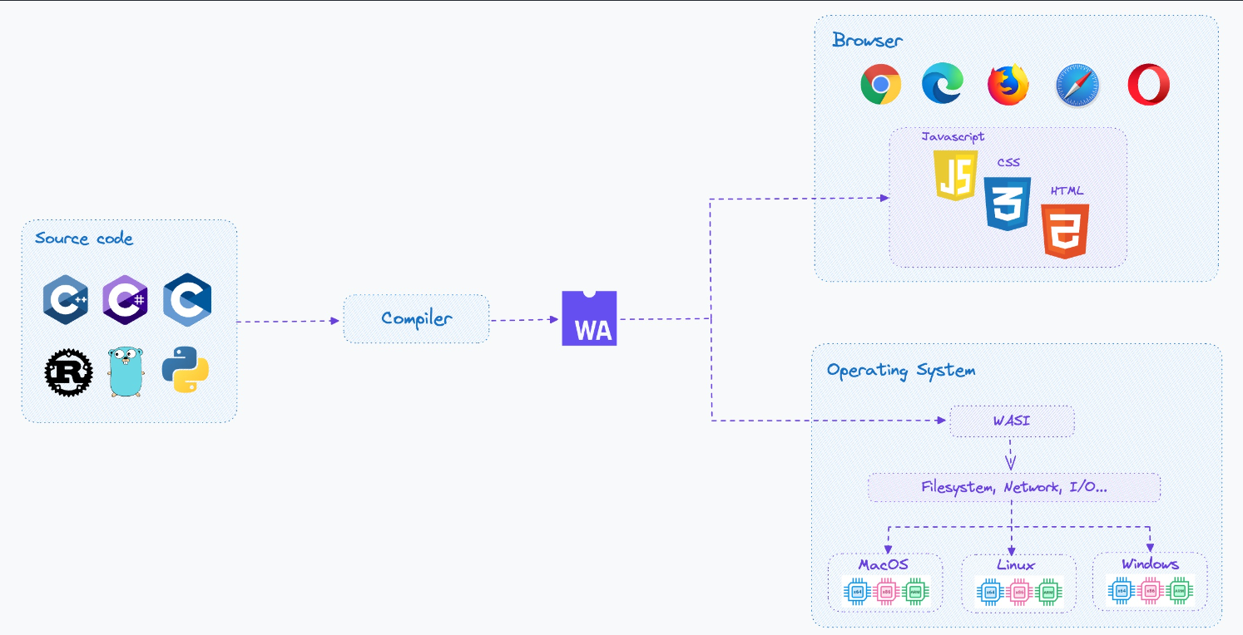
WebAssembly

Slide 6
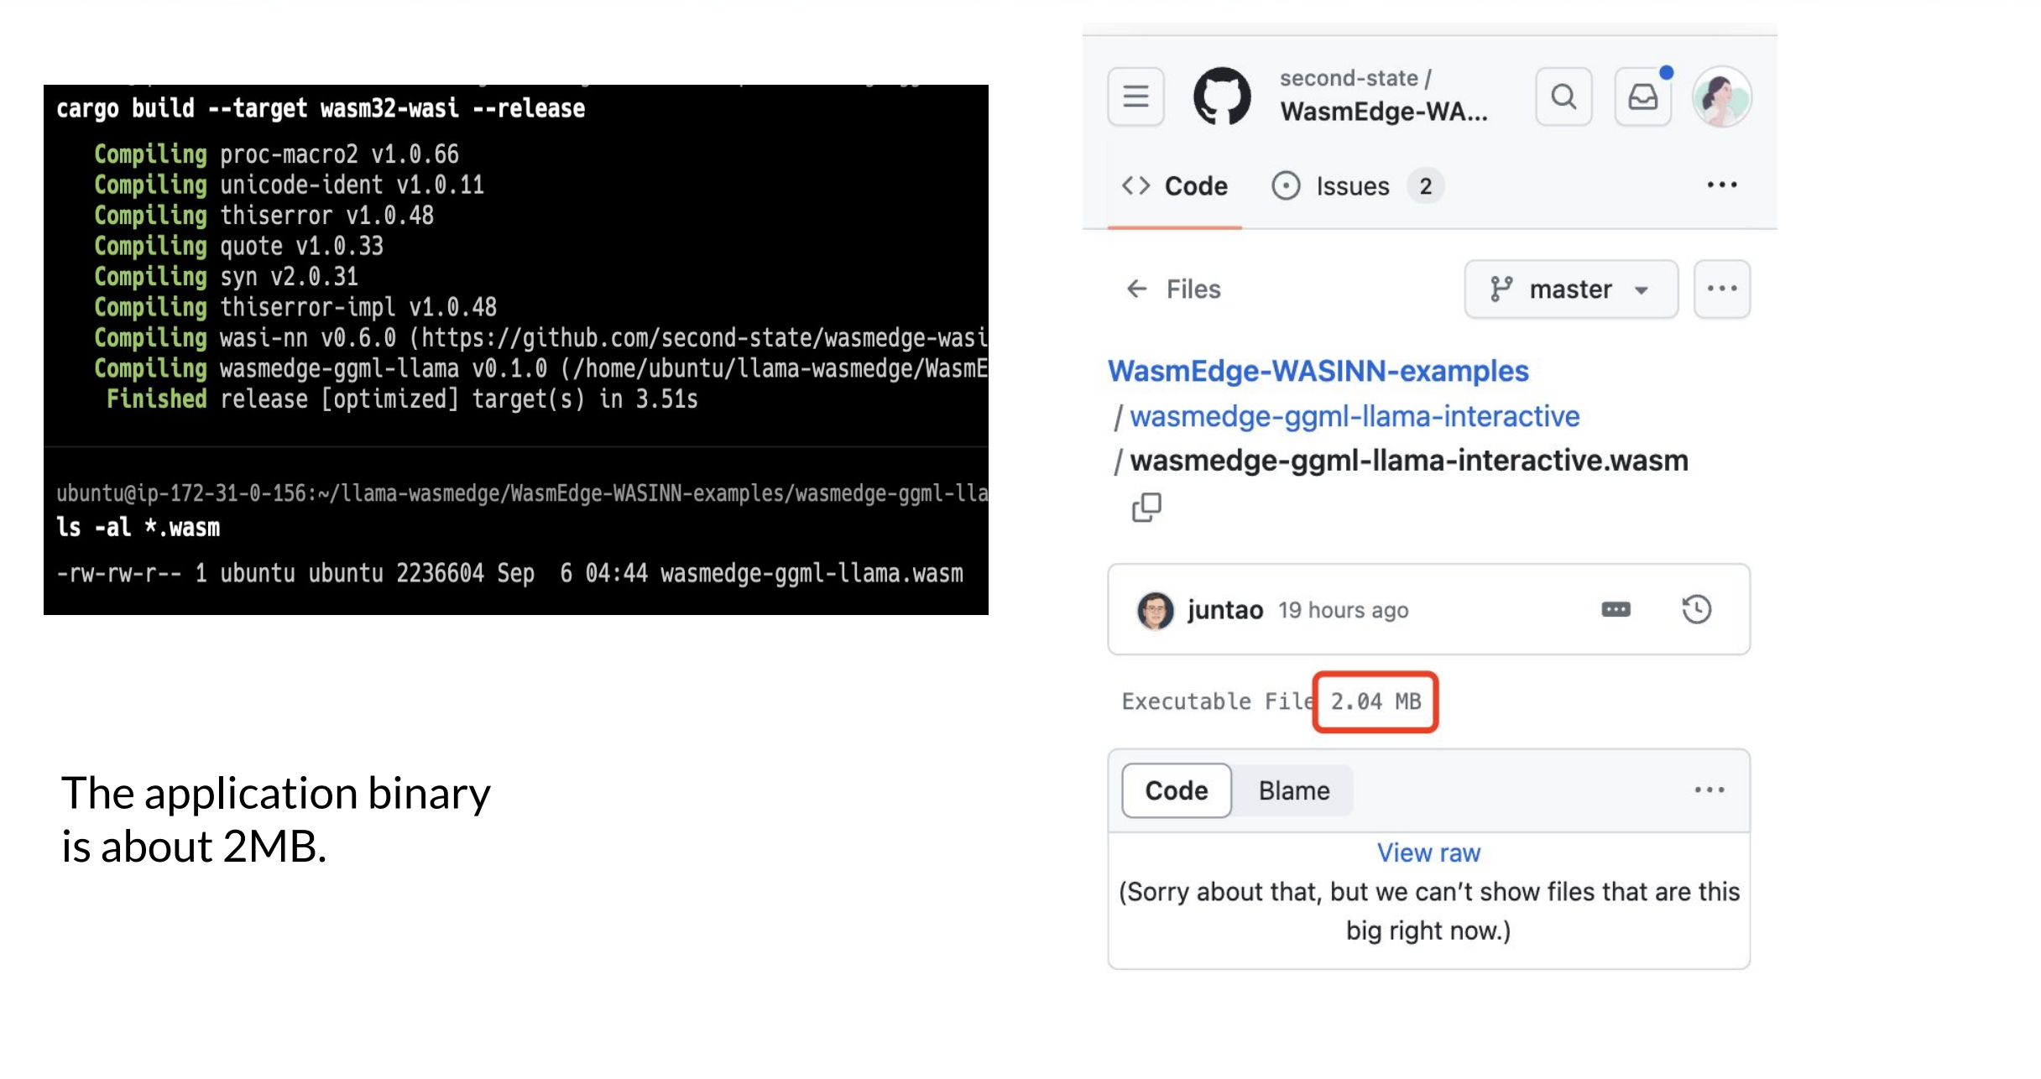
WebAssembly + AI
Develop, Build & Deploy Lightweight AI Services with WebAssembly - Kinfey Lo, Microsoft; Vivian Hu, Second State; Jianbai Ye
Wasm has emerged as a strong alternative runtime for AI inference workloads.
Developers write inference functions in Rust / JS / Python and then run them in Wasm sandboxes.
Wasm functions are lightweight, fast, safe for the cloud, and can be managed by container tools.

Slide 7
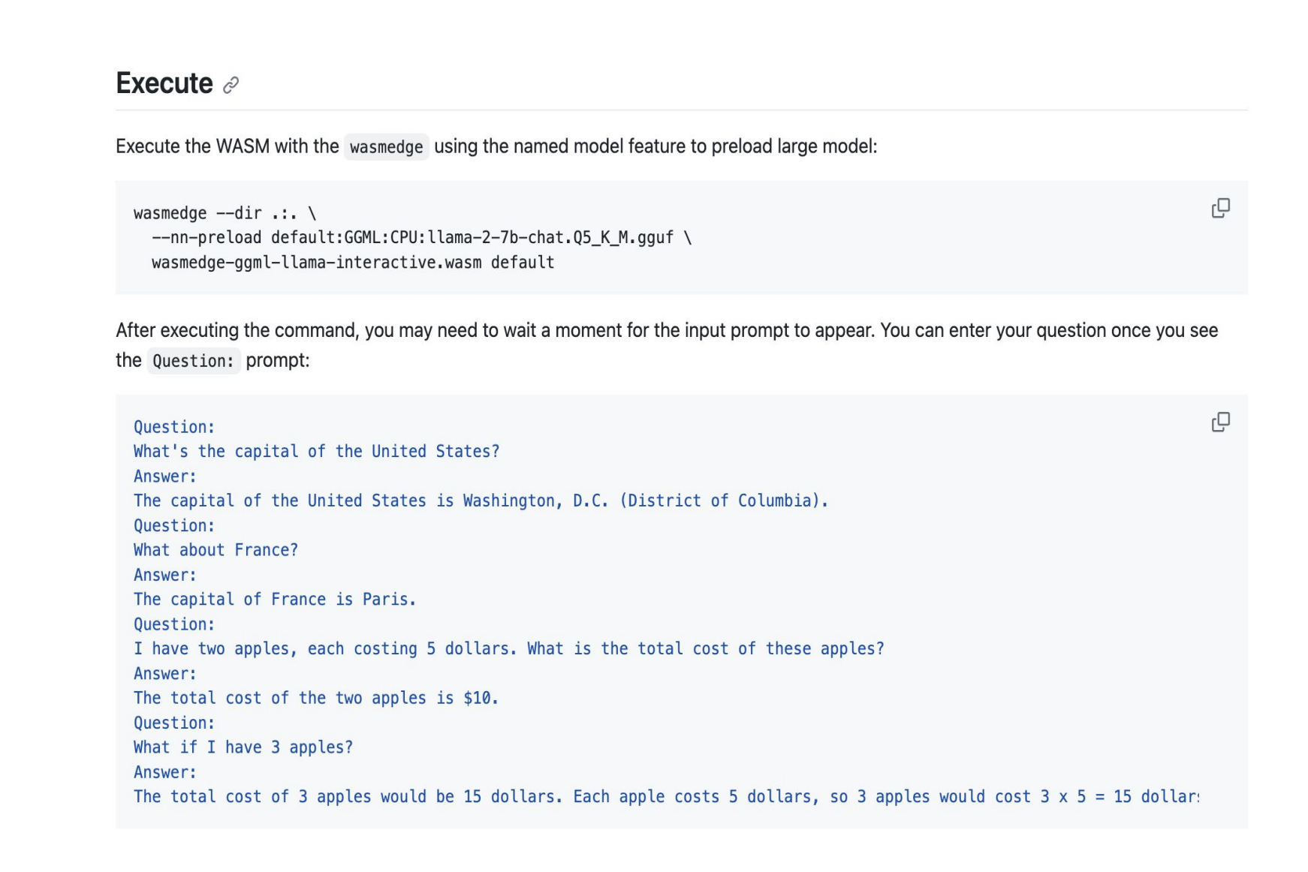
WebAssembly + AI
https://github.com/second-state
/WasmEdge-WASINN-examples
/blob/master/wasmedge-ggml-ll
ama-interactive/

Slide 8
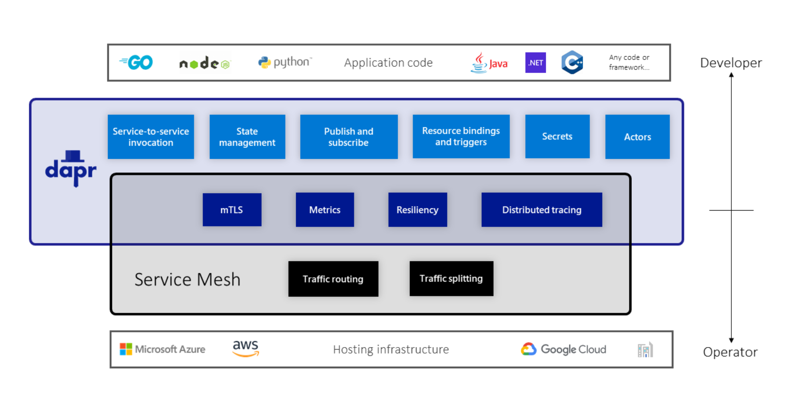
WebAssembly + Dapr
The State and Future of WebAssembly in Dapr - Loong Dai, Intel

Slide 9
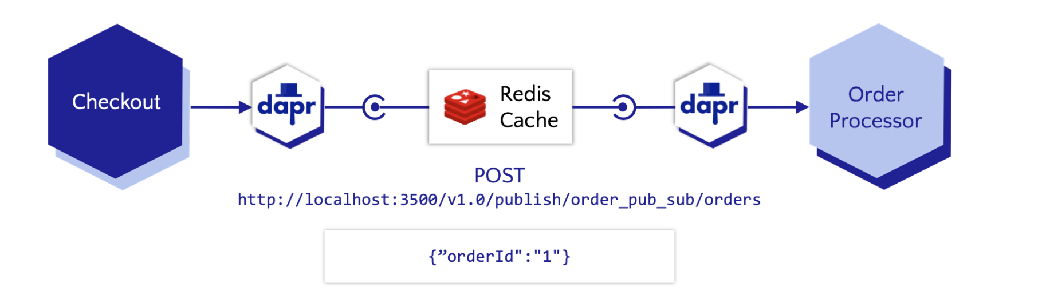
WebAssembly + Dapr

Slide 10
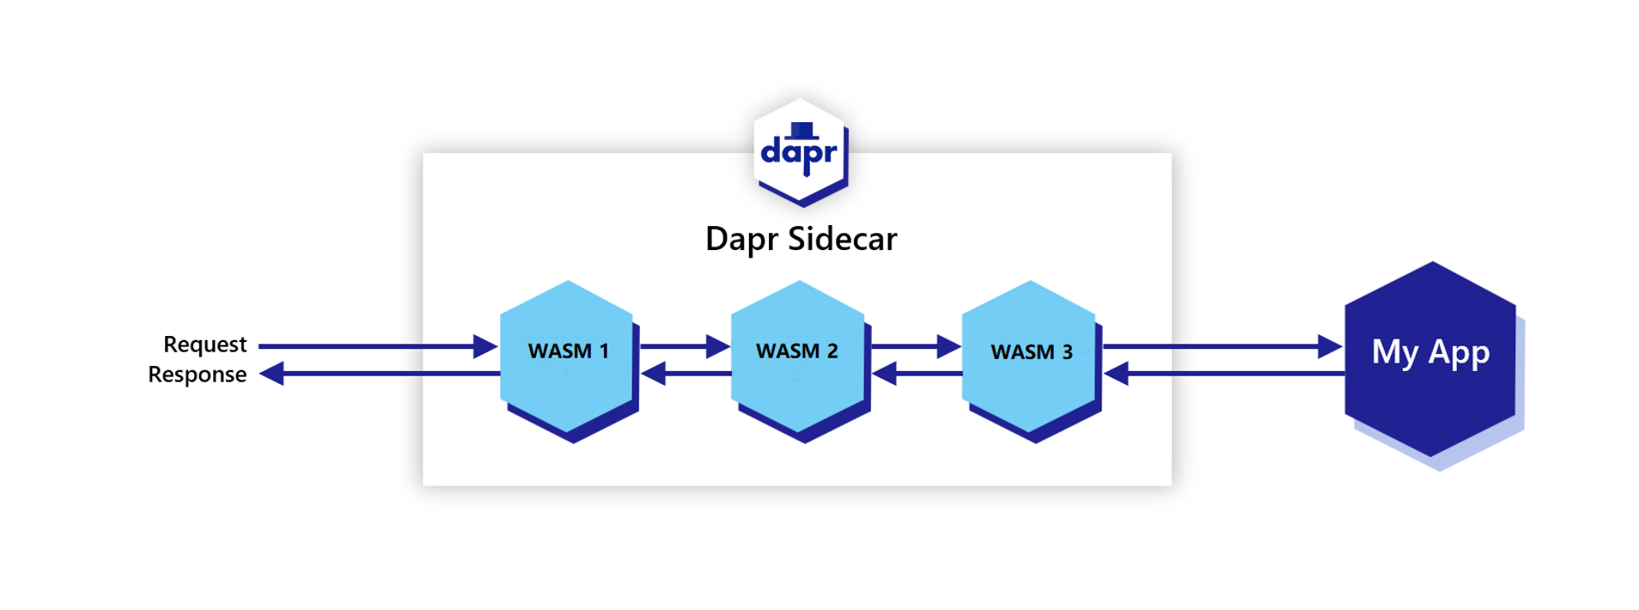
WebAssembly + Dapr

Slide 11
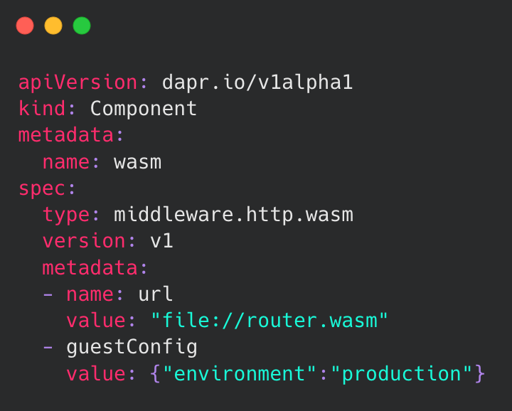
WebAssembly + Dapr
The Wasm HTTP middleware allows you to manipulate an incoming request or serve a response with custom logic compiled to a Wasm binary. In other words, you can extend Dapr using external files that are not pre-compiled into the daprd binary.

Slide 12
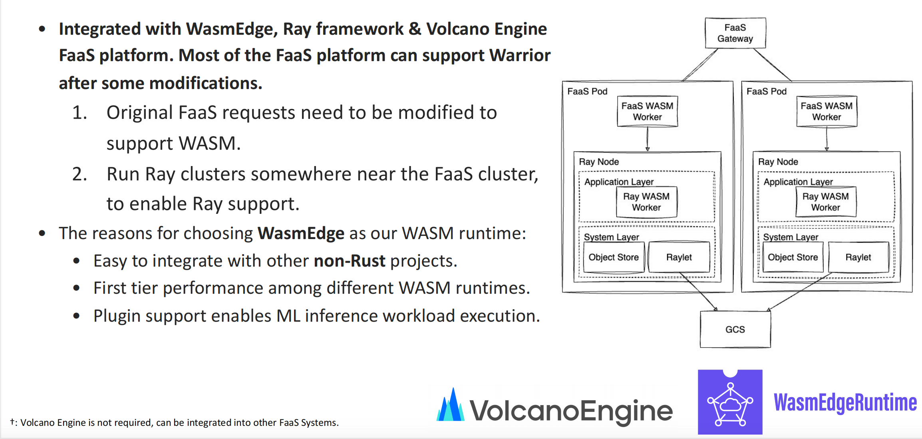
WebAssembly-Based Fass Framework
WebAssembly-Based FaaS Framework with Distributed Machine Learning Capabilities –
Wilson Wang, ByteDance & Michael Yuan, Second State

Slide 13
eBPF

Slide 14
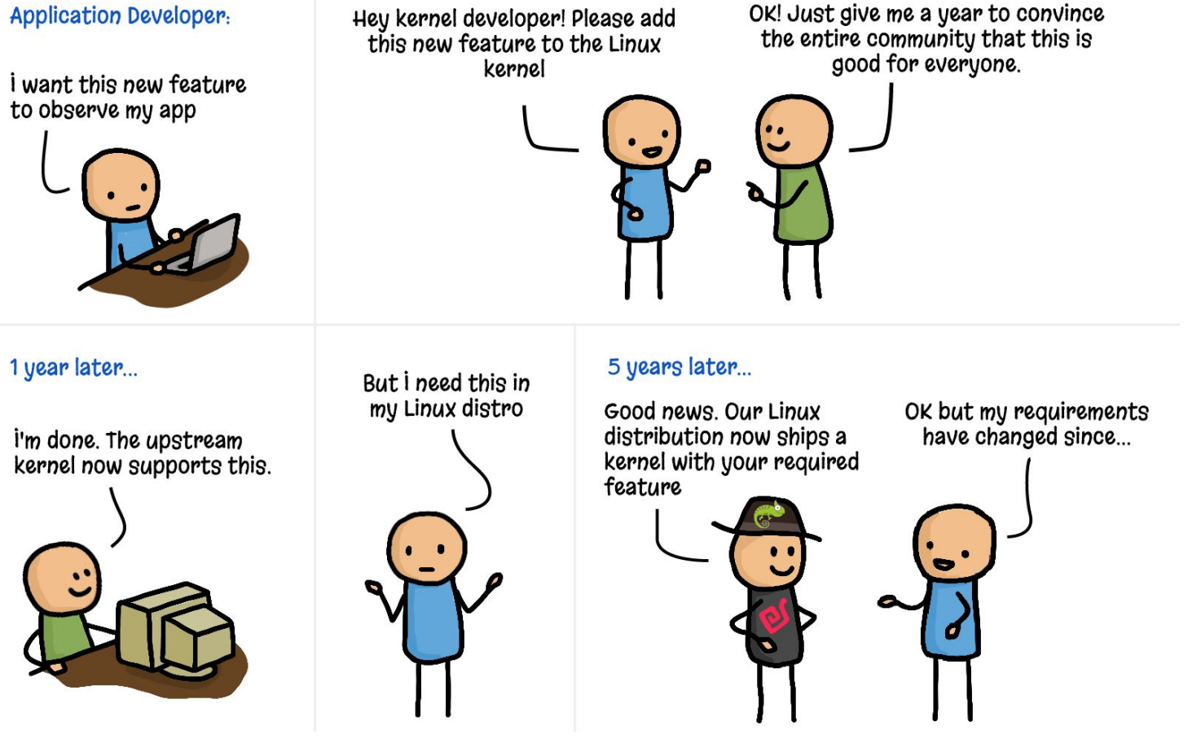
eBPF in Cloud Native
Just Buzz or Real Byte? eBPF in Cloud Native - Bill Mulligan, Isovalent

Slide 15
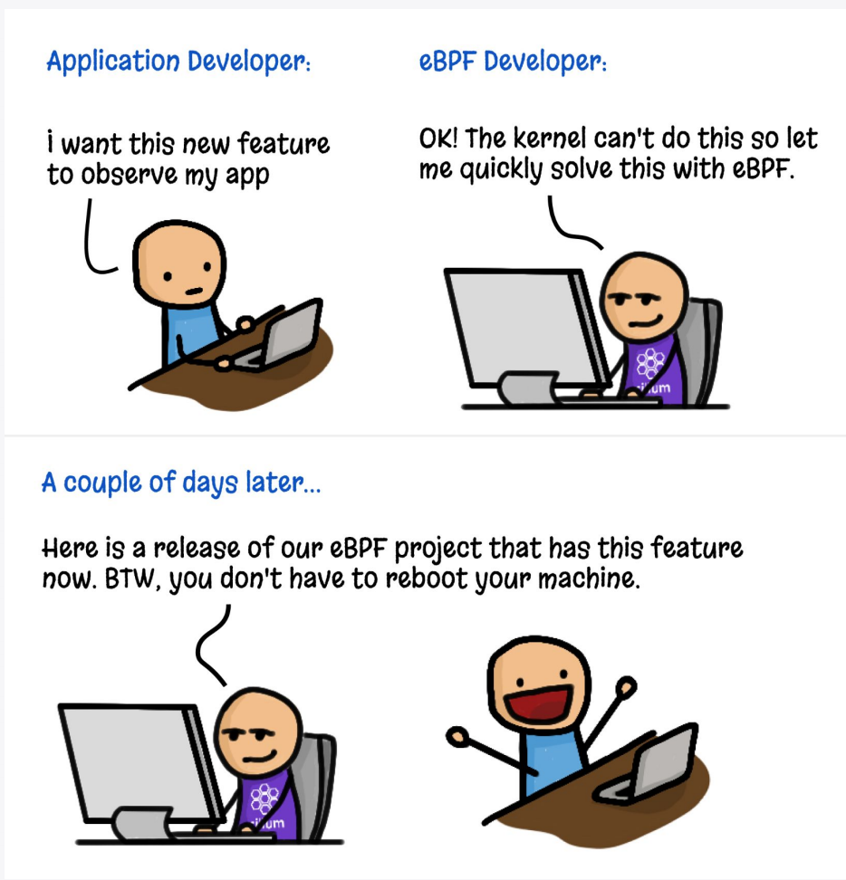
eBPF in Cloud Native

Slide 16
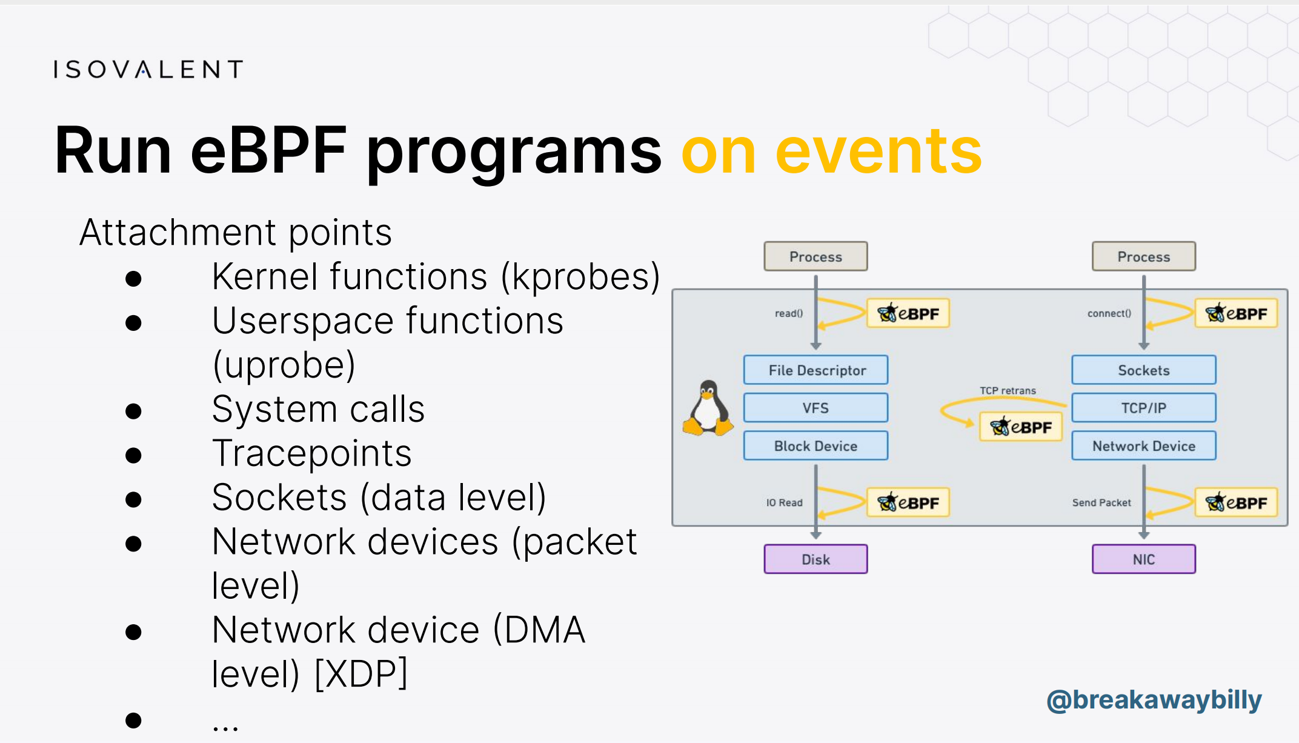
eBPF in Cloud Native

Slide 17
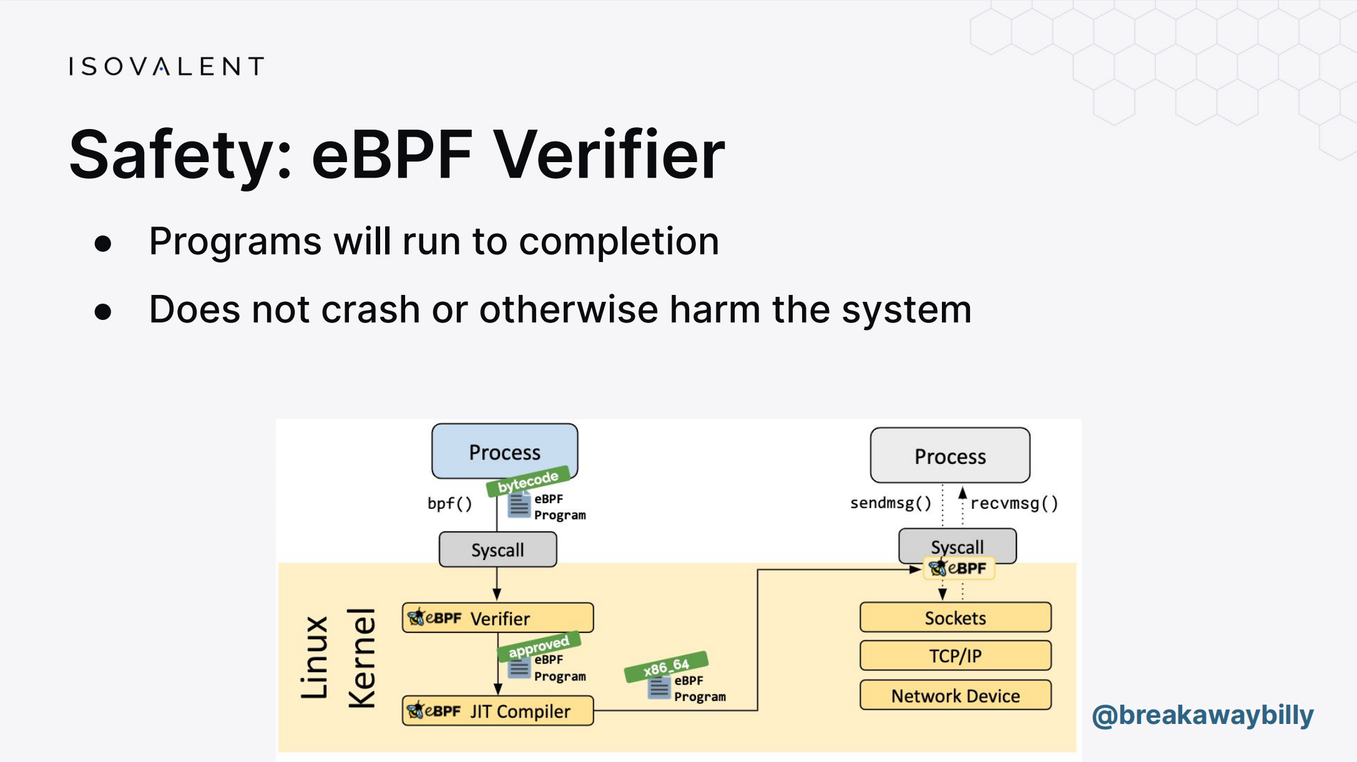
eBPF in Cloud Native

Slide 18
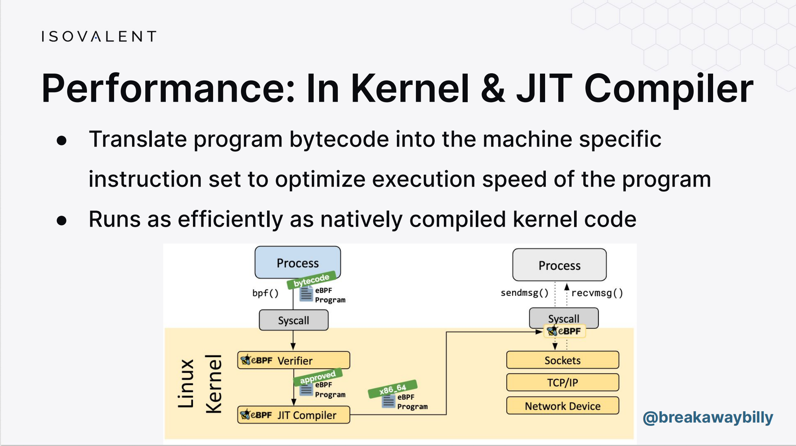
eBPF in Cloud Native

Slide 19
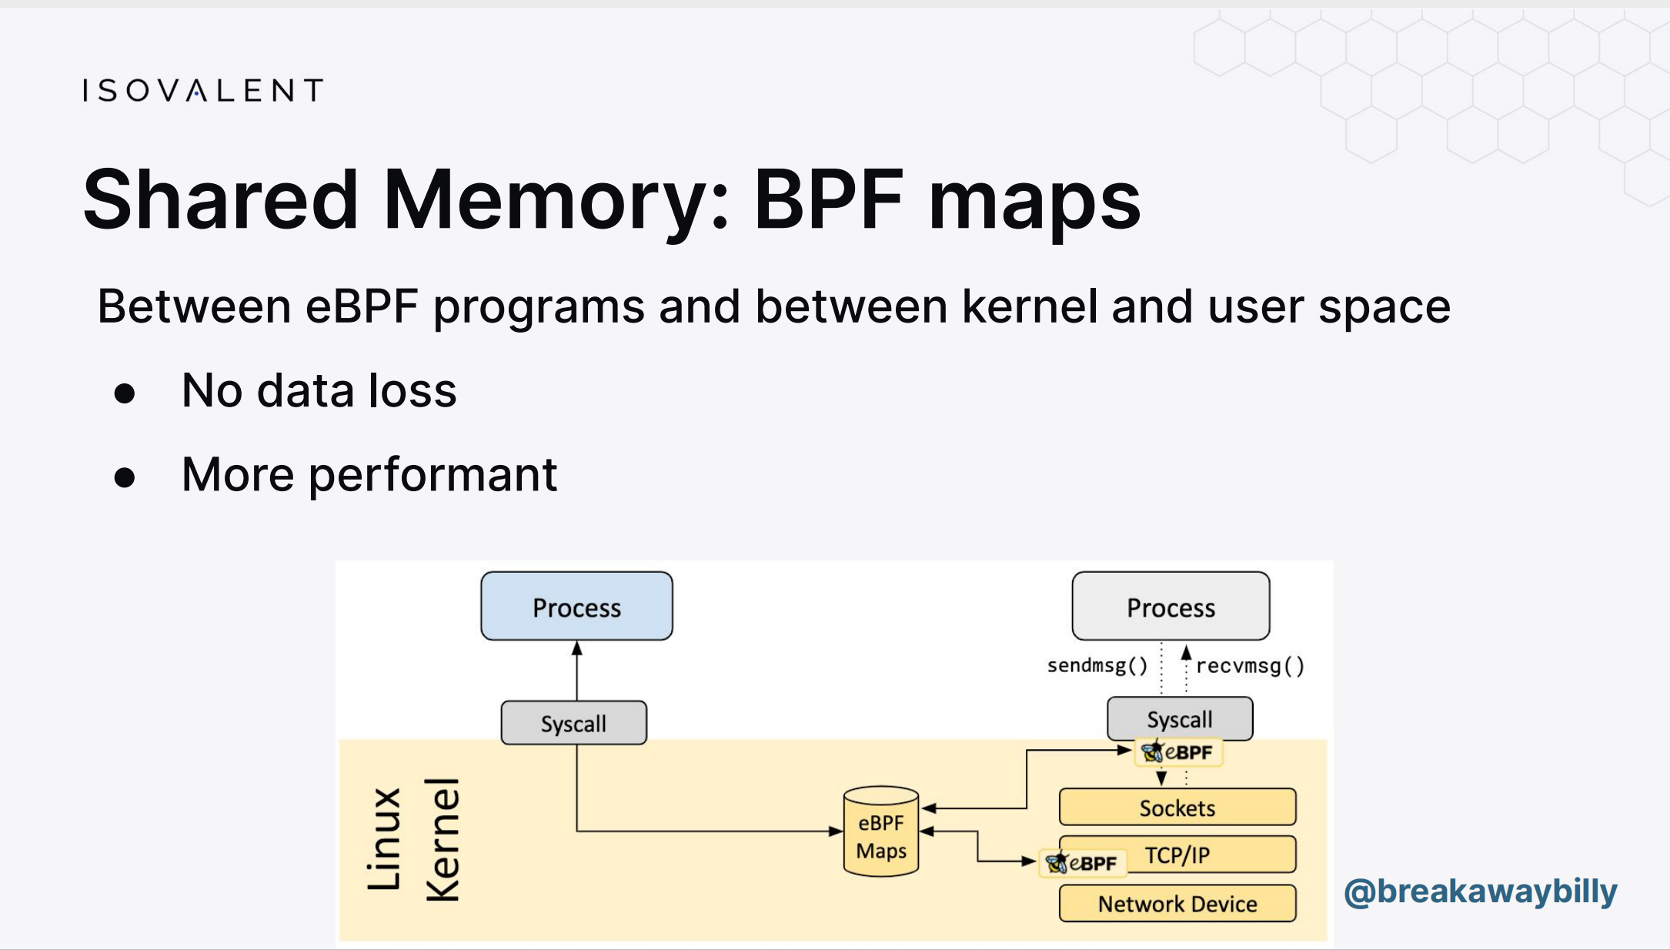
eBPF in Cloud Native

Slide 20
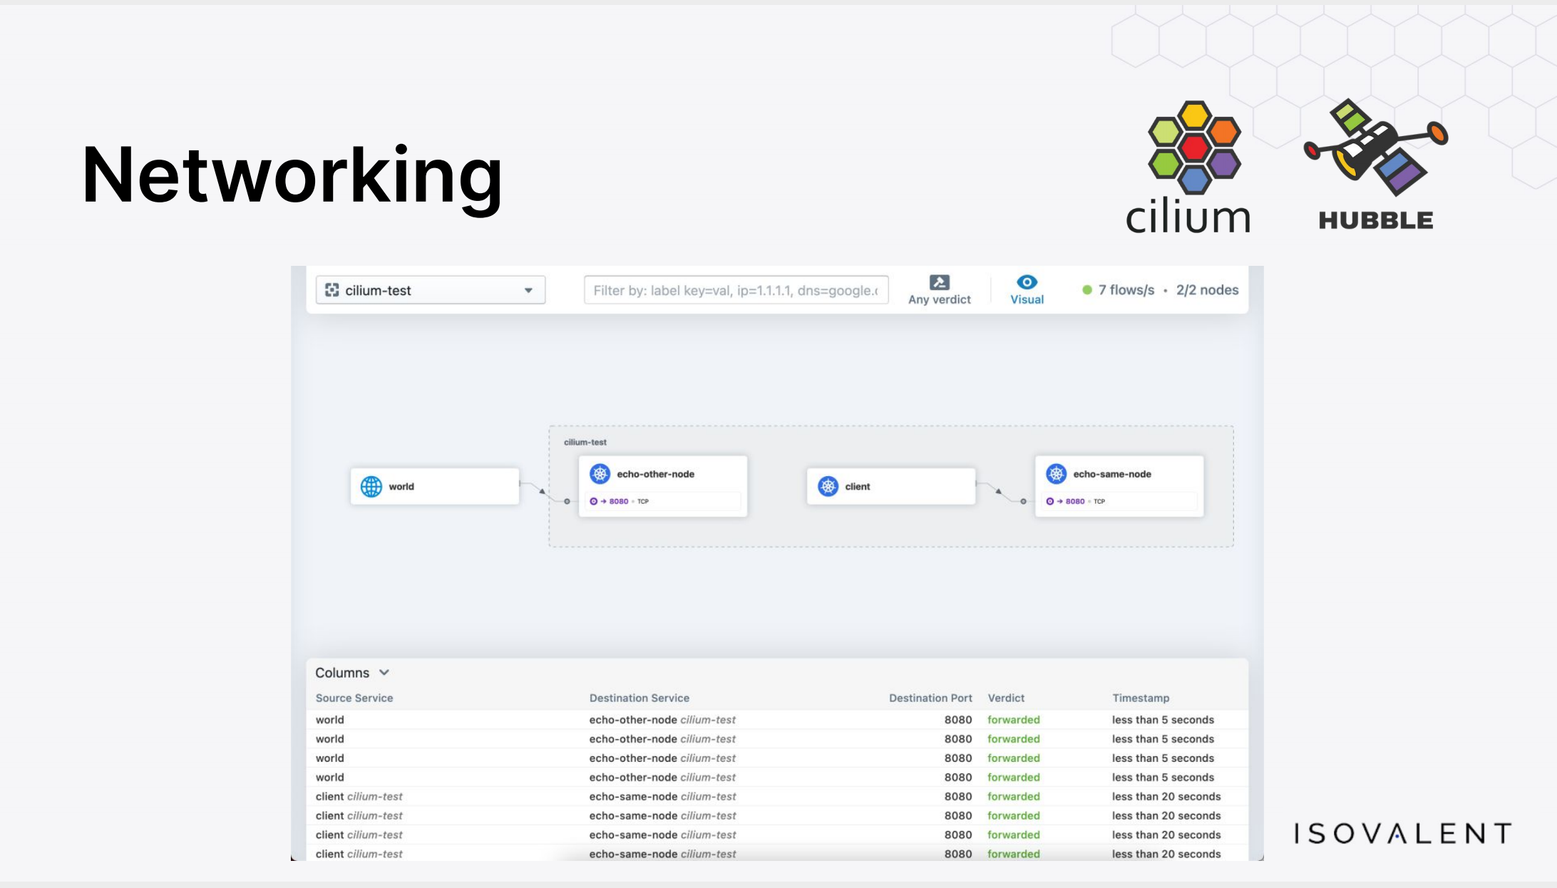
eBPF in Cloud Native

Slide 21
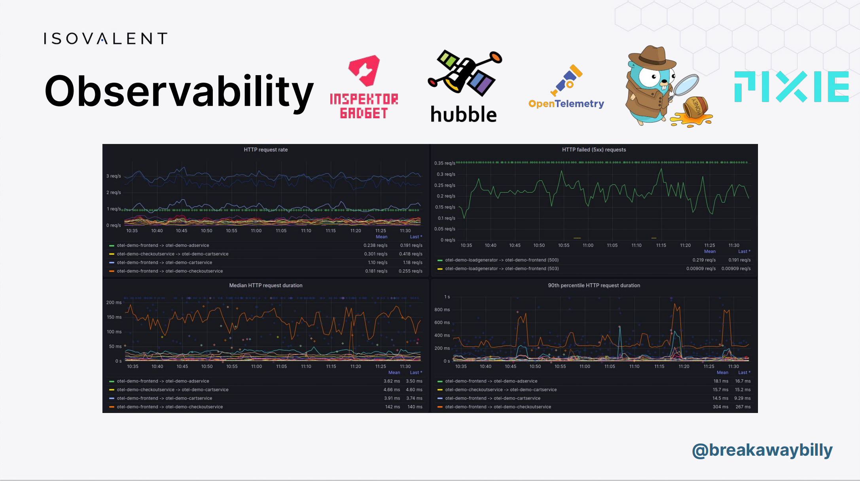
eBPF in Cloud Native

Slide 22
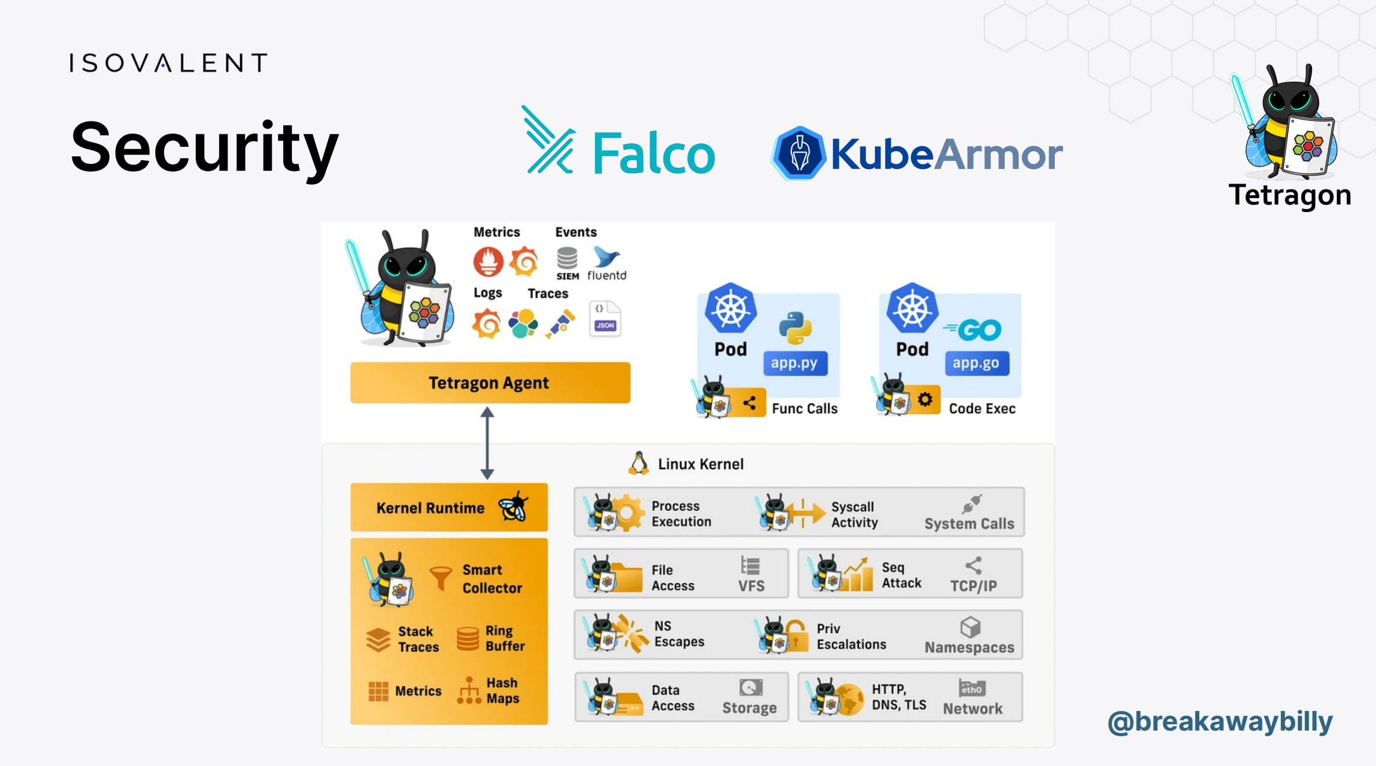
eBPF in Cloud Native

Slide 23
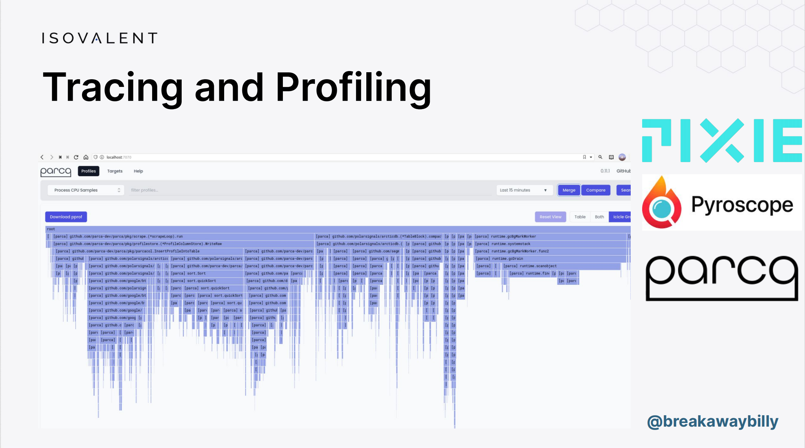
eBPF in Cloud Native

Slide 24
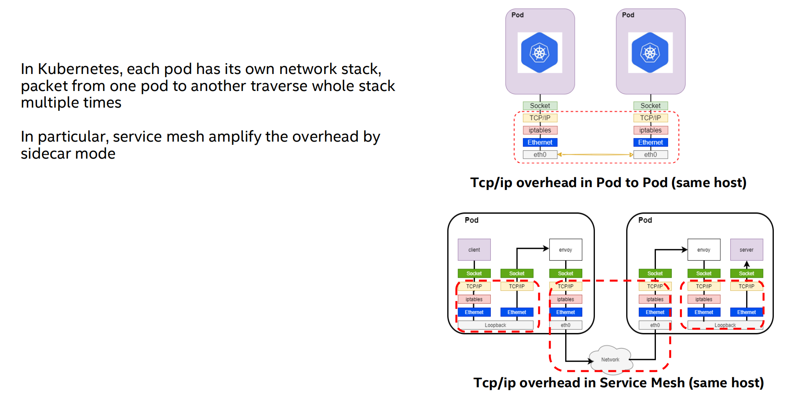
TCP/IP Bypass with eBPF in Istio
CNI-Agnostic Network Performance Accelerator with eBPF - Mengxin Liu, Alauda & Yizhou Xu, Intel https://github.com/intel/istio-tcpip-bypass

Slide 25
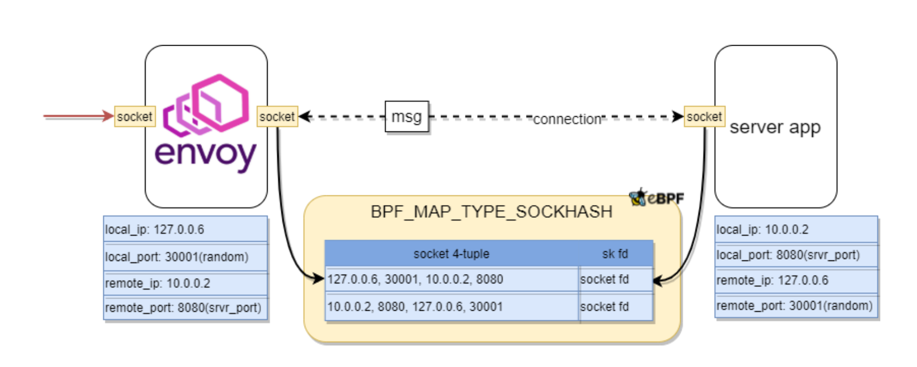
TCP/IP Bypass with eBPF in Istio

Slide 26
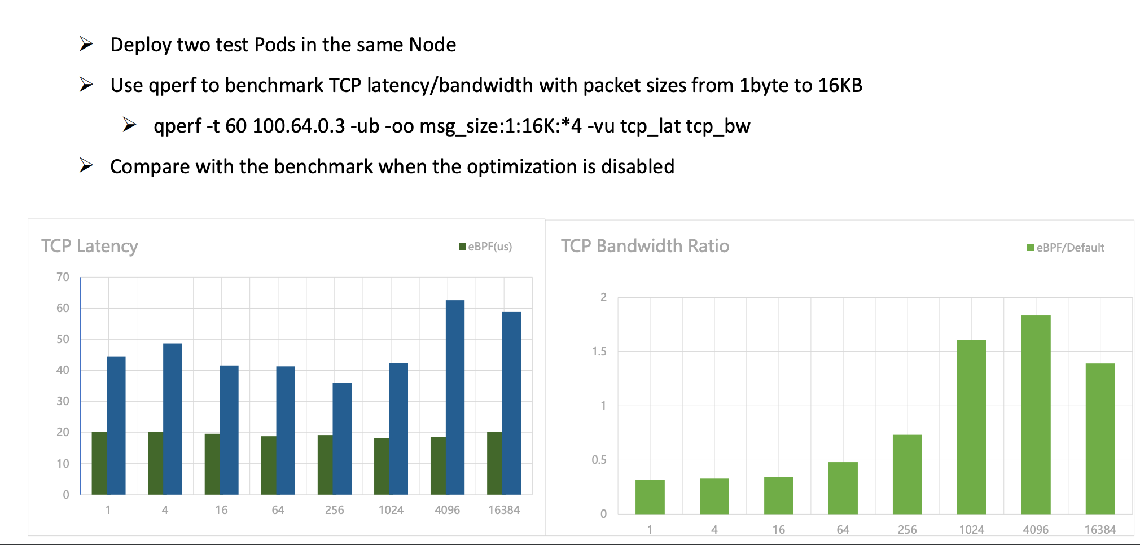
TCP/IP Bypass with eBPF in Istio

Slide 27
Security

Slide 28
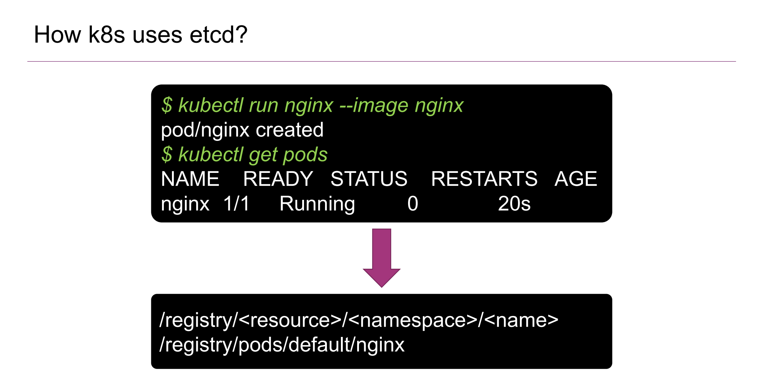
Post-exploiting etcd
Post-Exploiting a Compromised ETCD - Luis Toro Puig, NCC Group

Slide 29
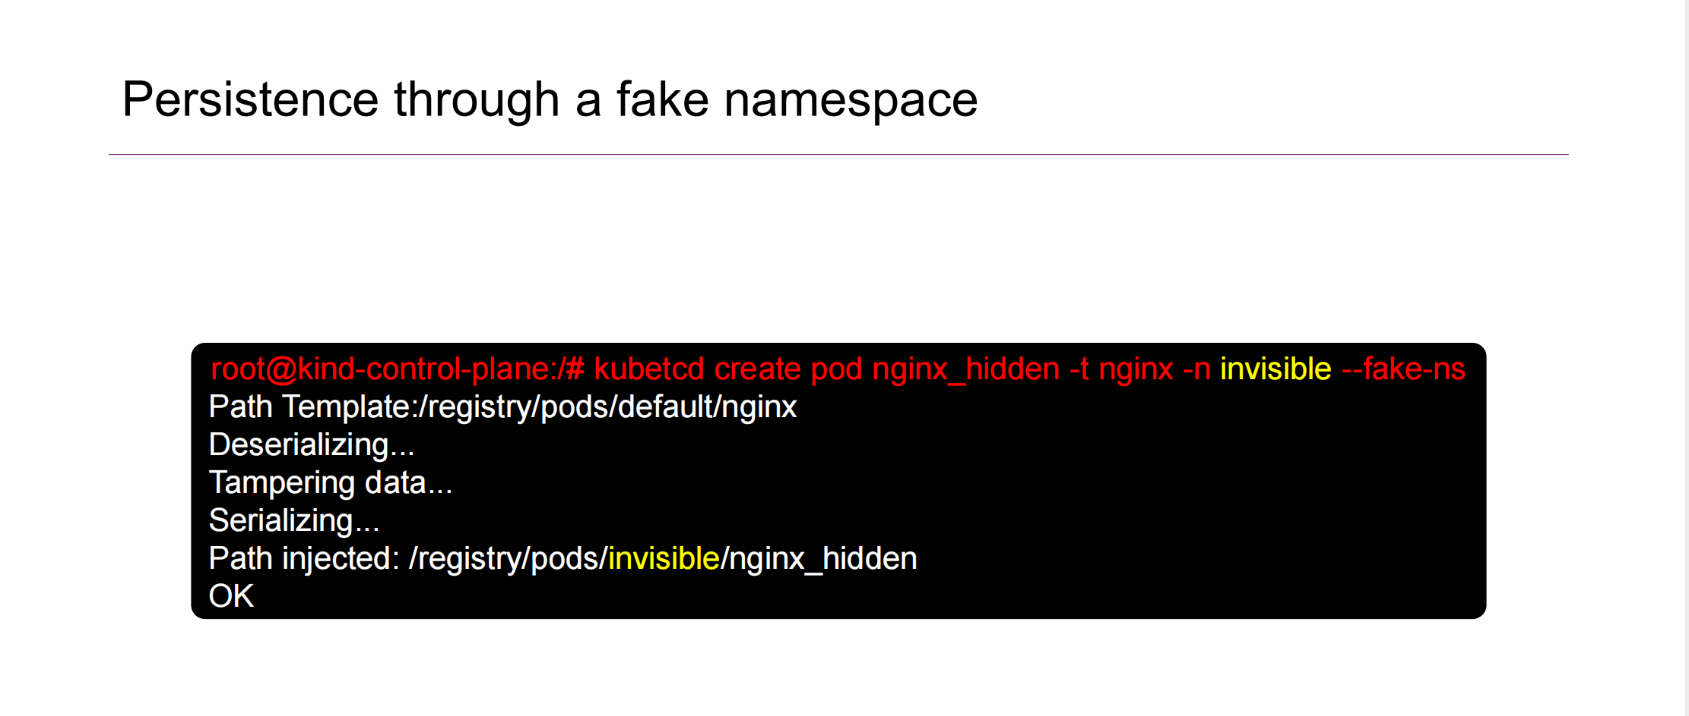
Post-exploiting etcd

Slide 30
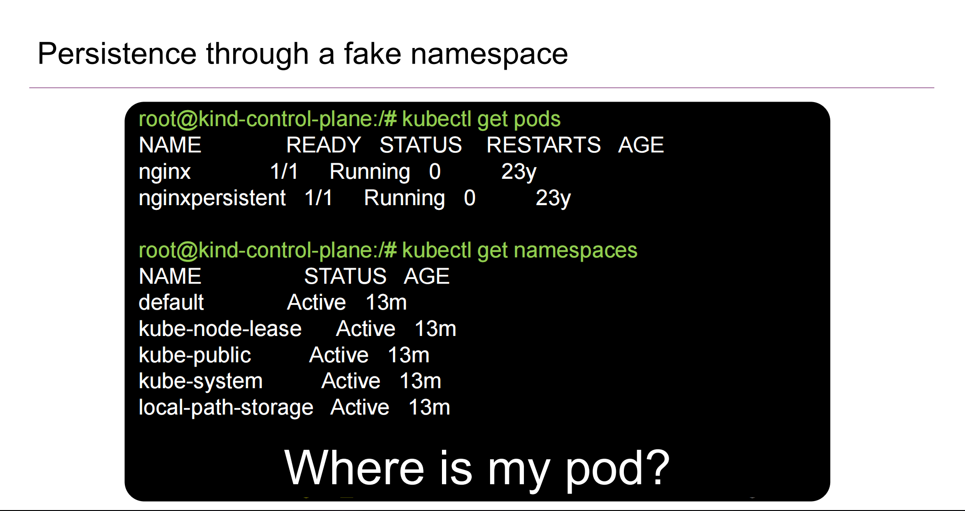
Post-exploiting etcd

Slide 31
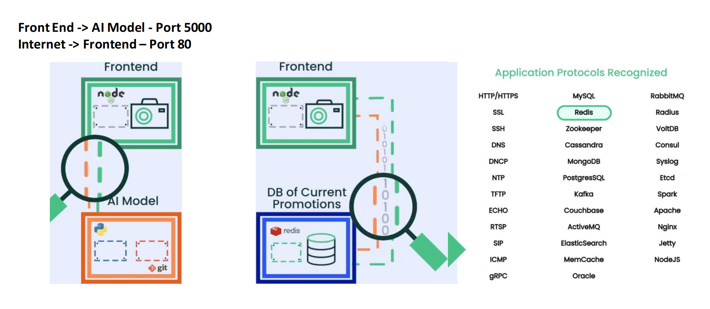
Neuvector
Automating Zero-Trust for Cloud Native Applications - Raul Mahiques & Erin Quill, SUSE

Slide 32
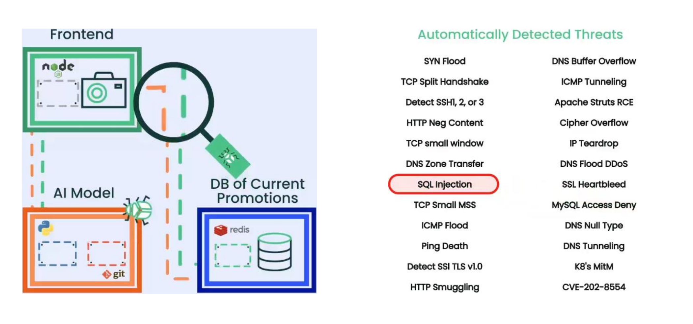
Neuvector

Slide 33
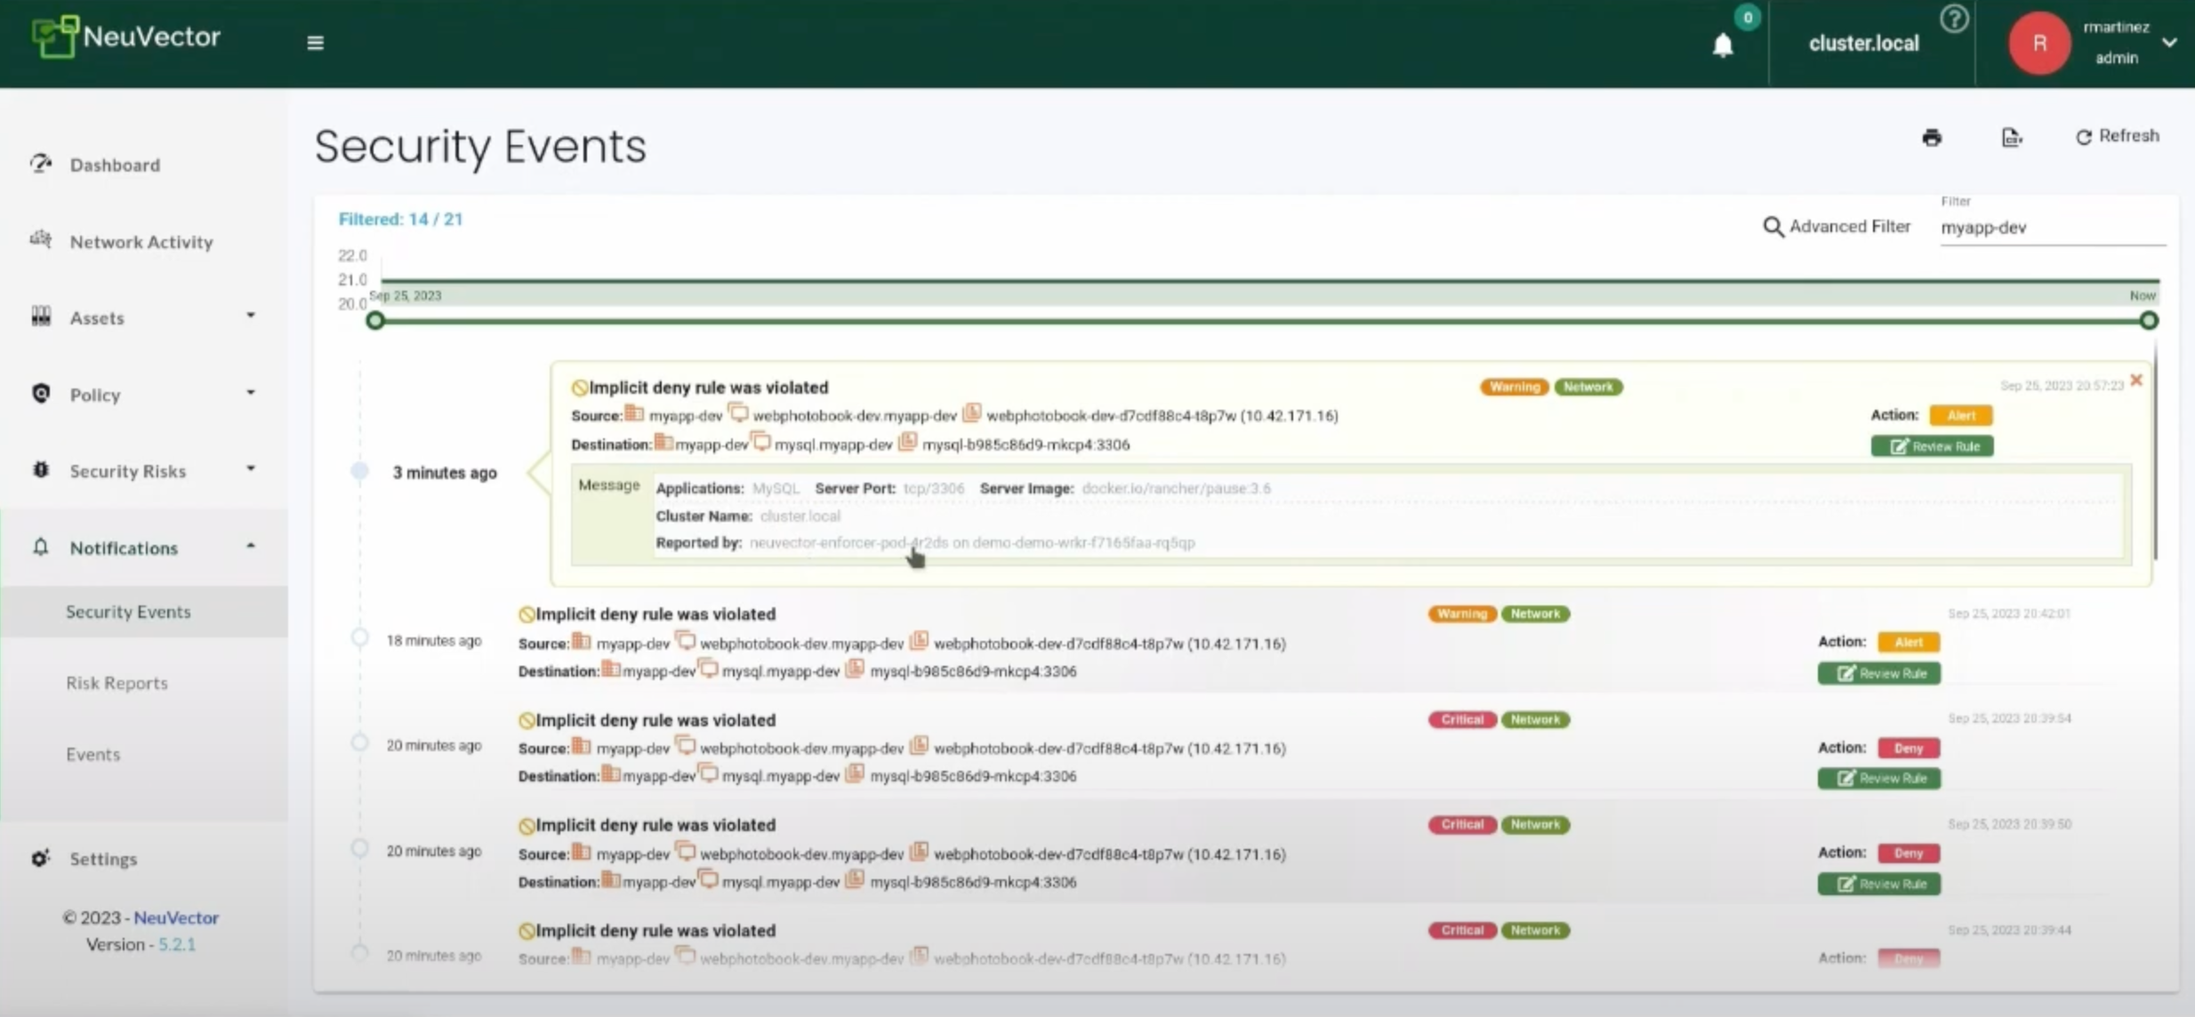
Neuvector

Slide 34
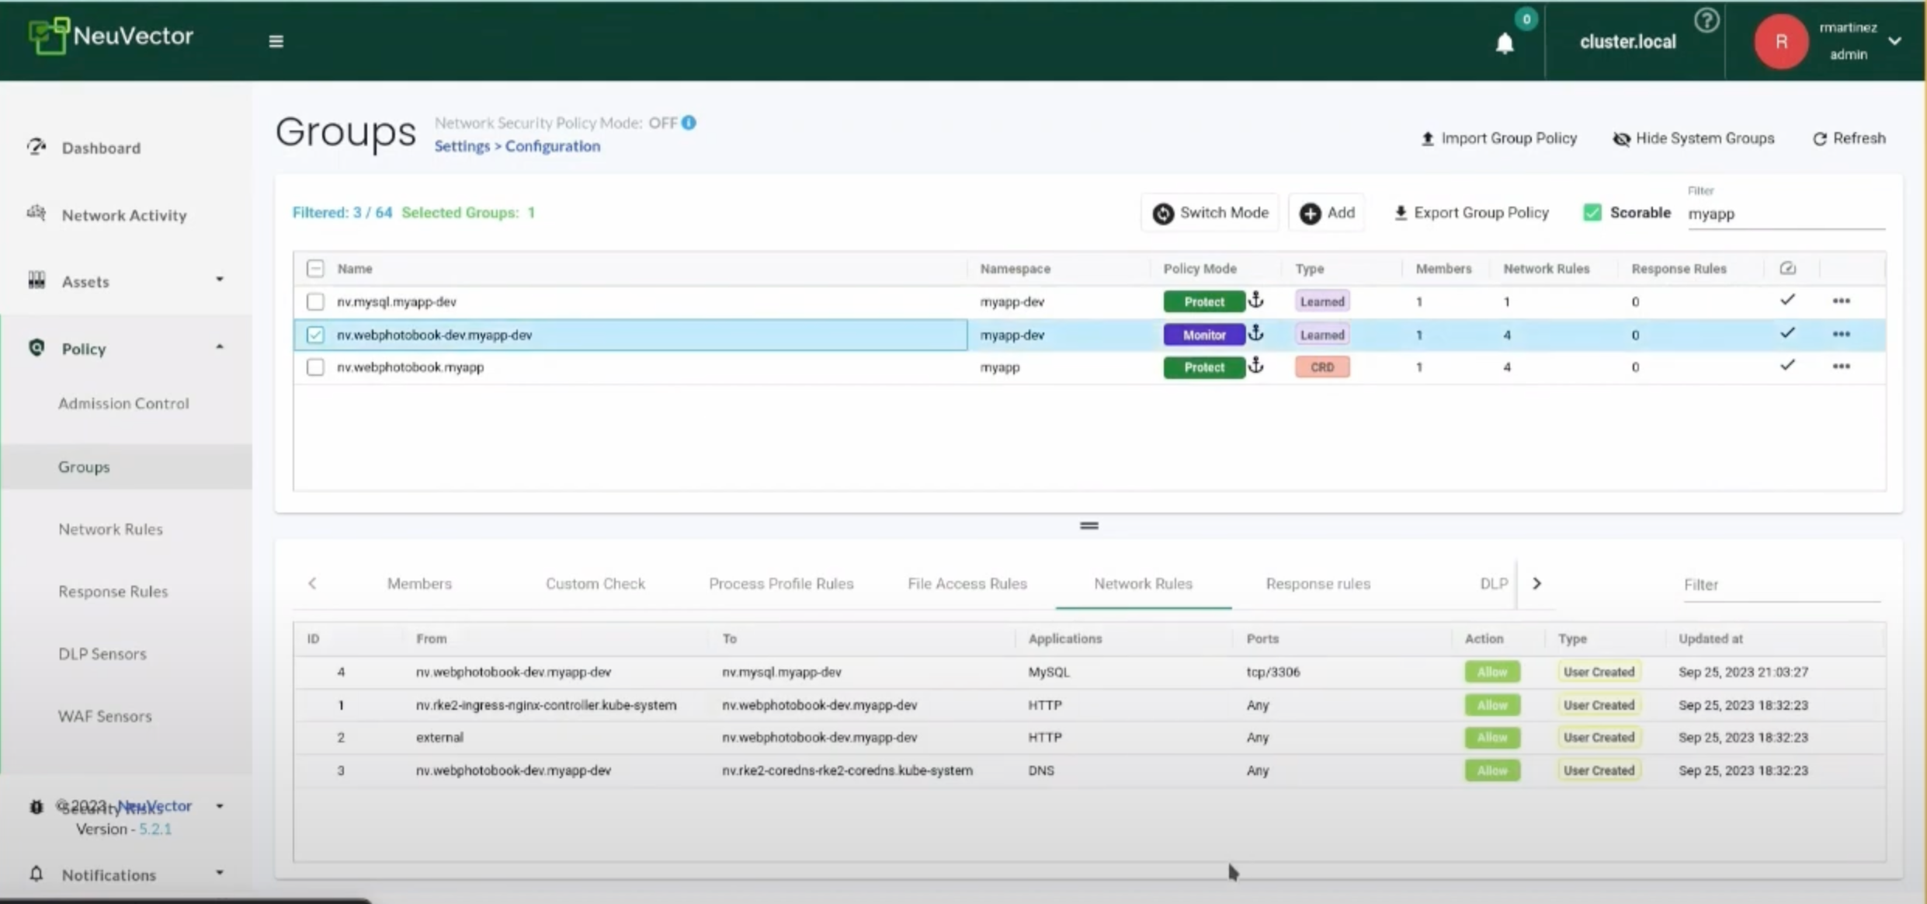
Neuvector

Slide 35
Neuvector

Slide 36
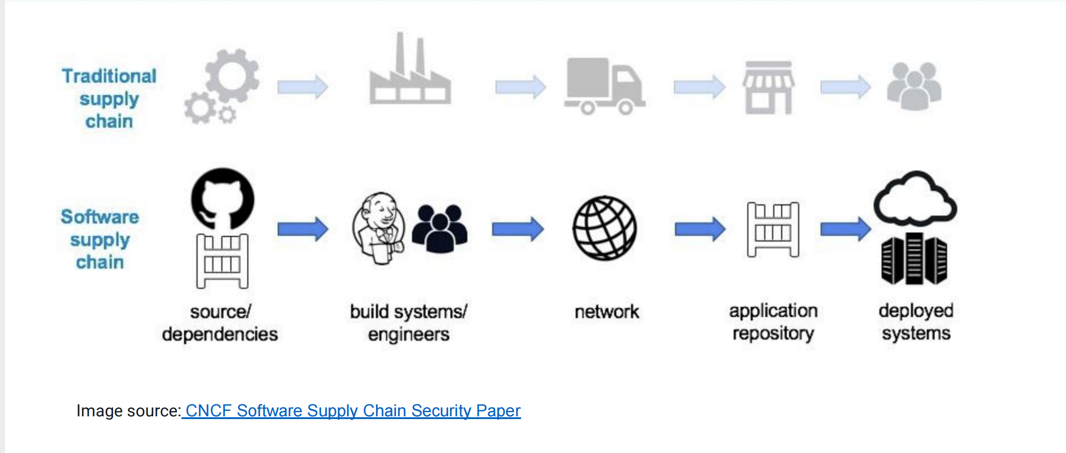
Software Supply Chain Security
Kicking Security Chain Attacks to the Curb with Kyverno and Notary in GitOps - Shuting Zhao, Nirmata & Feynman Zhou, Microsoft

Slide 37
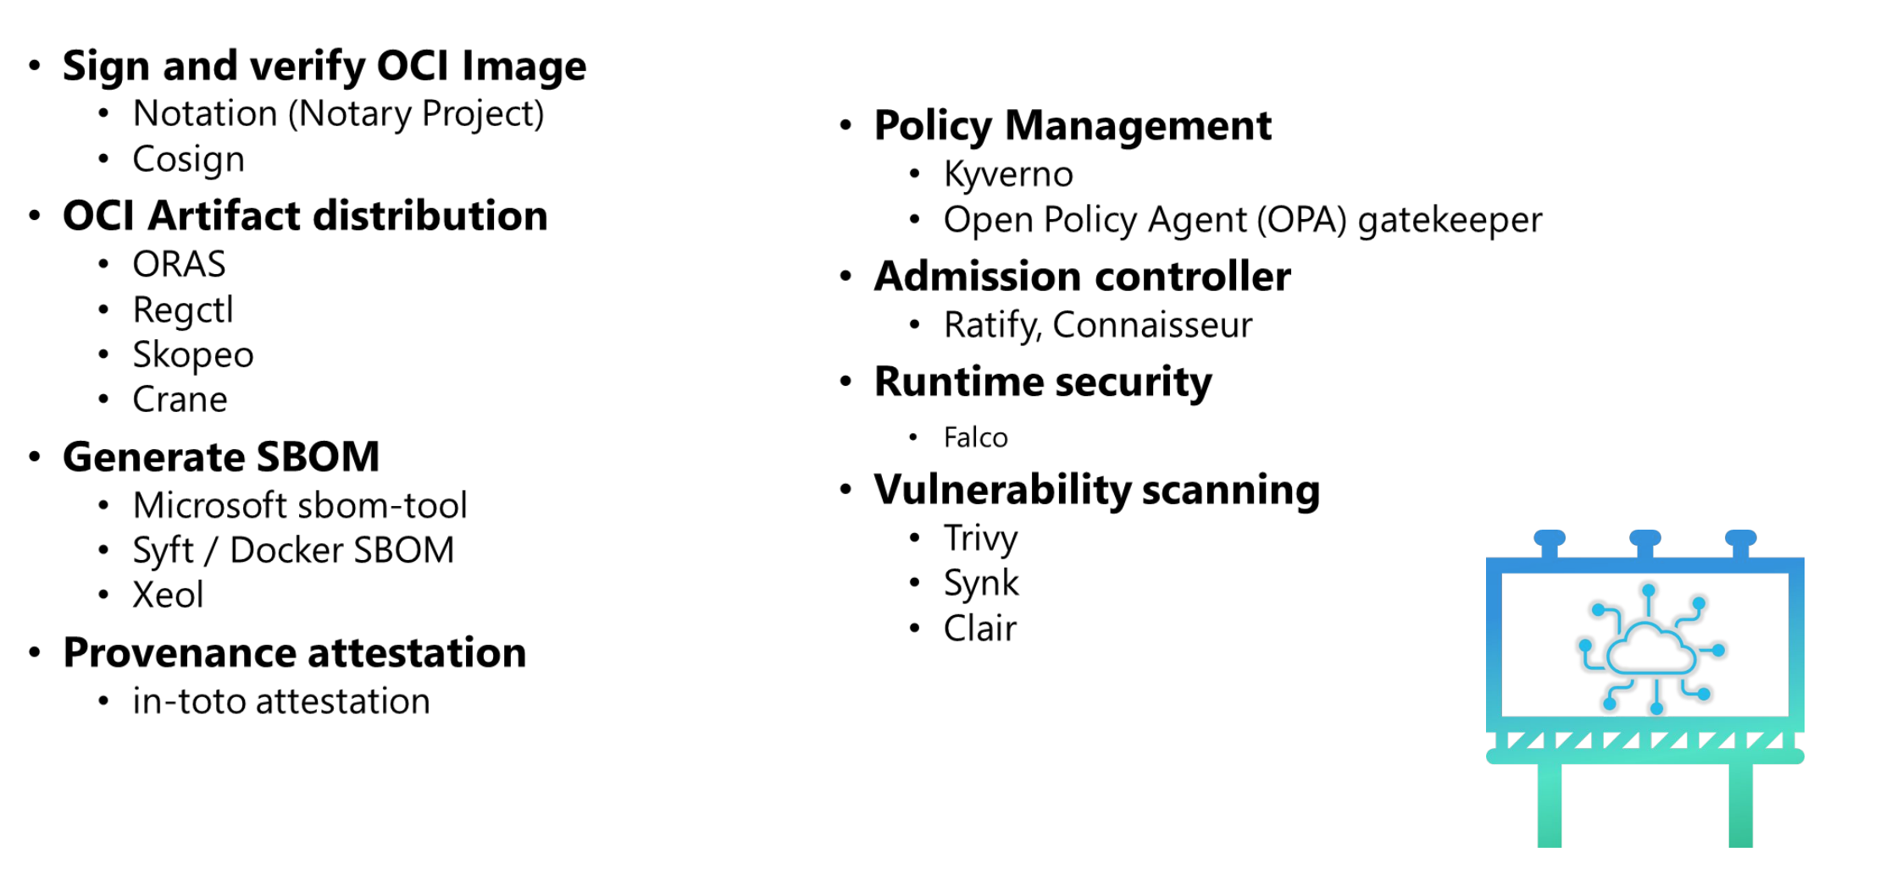
Software Supply Chain Security

Slide 38
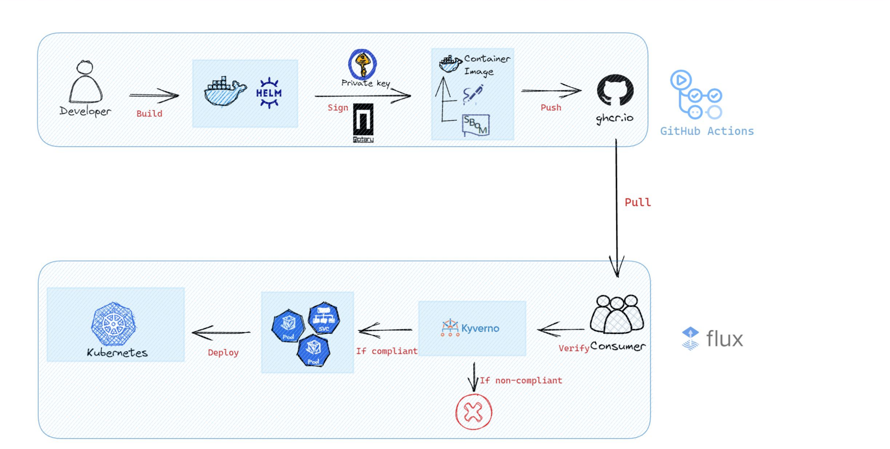
Software Supply Chain Security

Slide 39
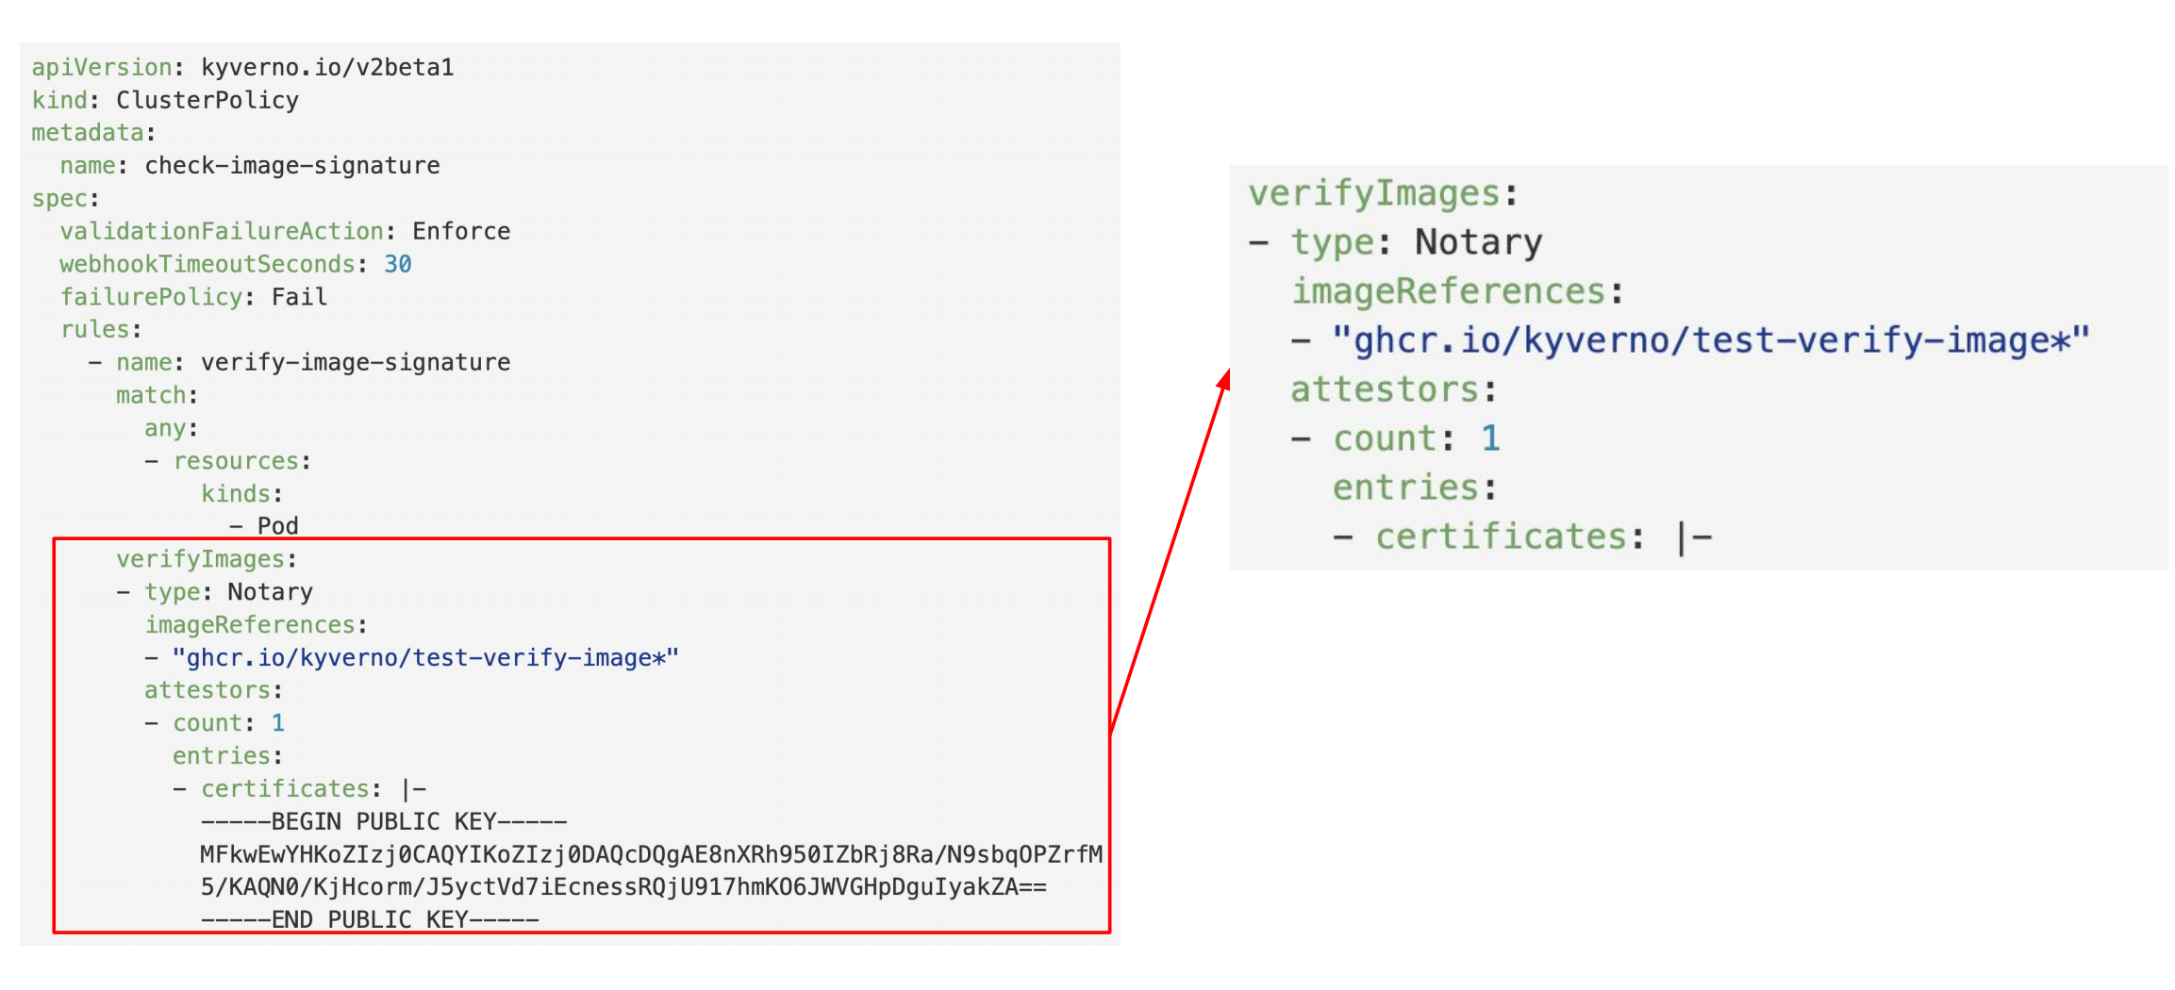
Software Supply Chain Security

Slide 40
Observability

Slide 41
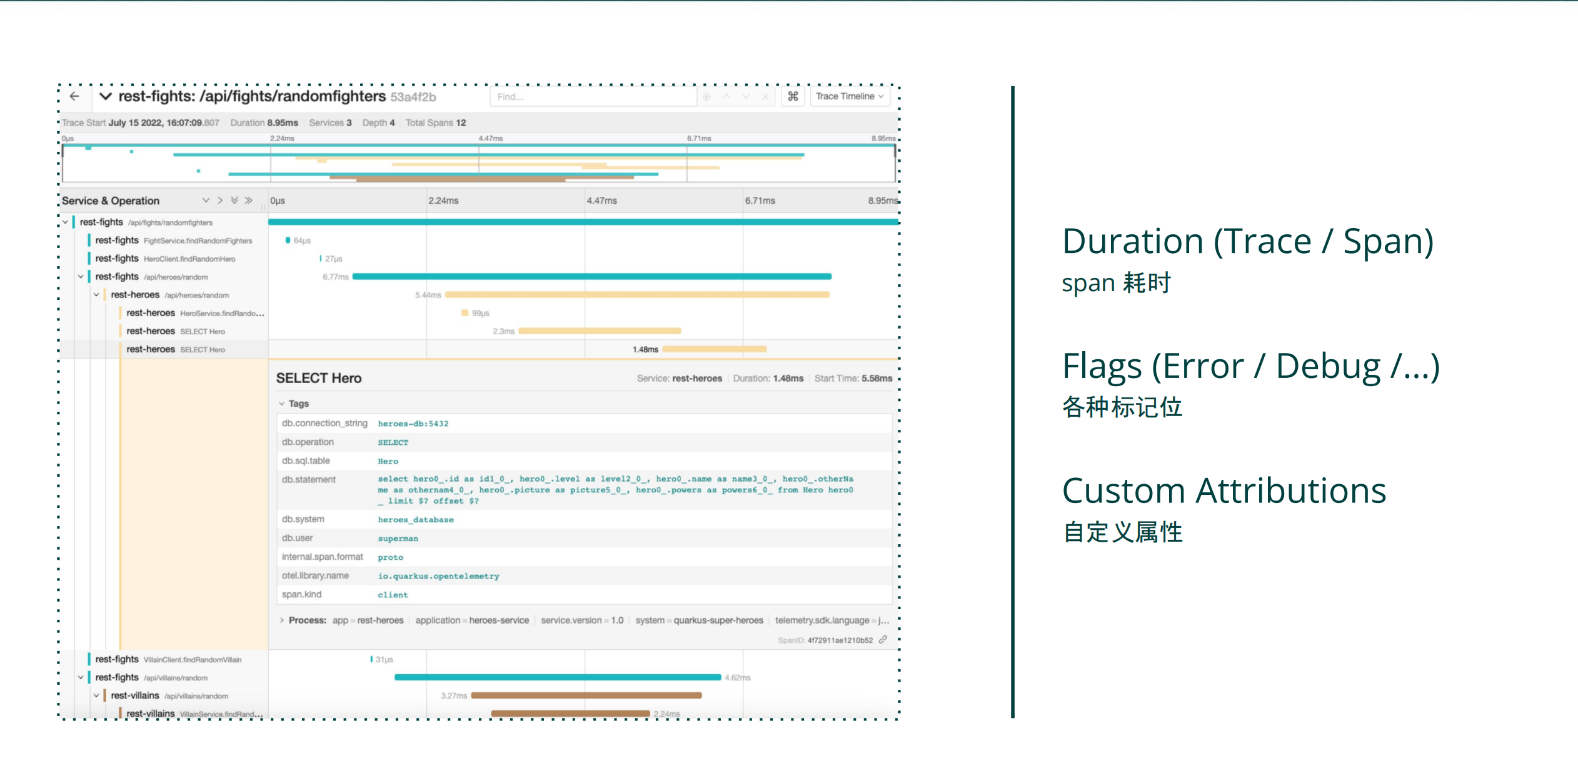
OpenTelemetry
Balancing Cost and Quality in OpenTelemetry: An Evaluation of Sampling Policies - Zhu Jiekun, Quwan

Slide 42
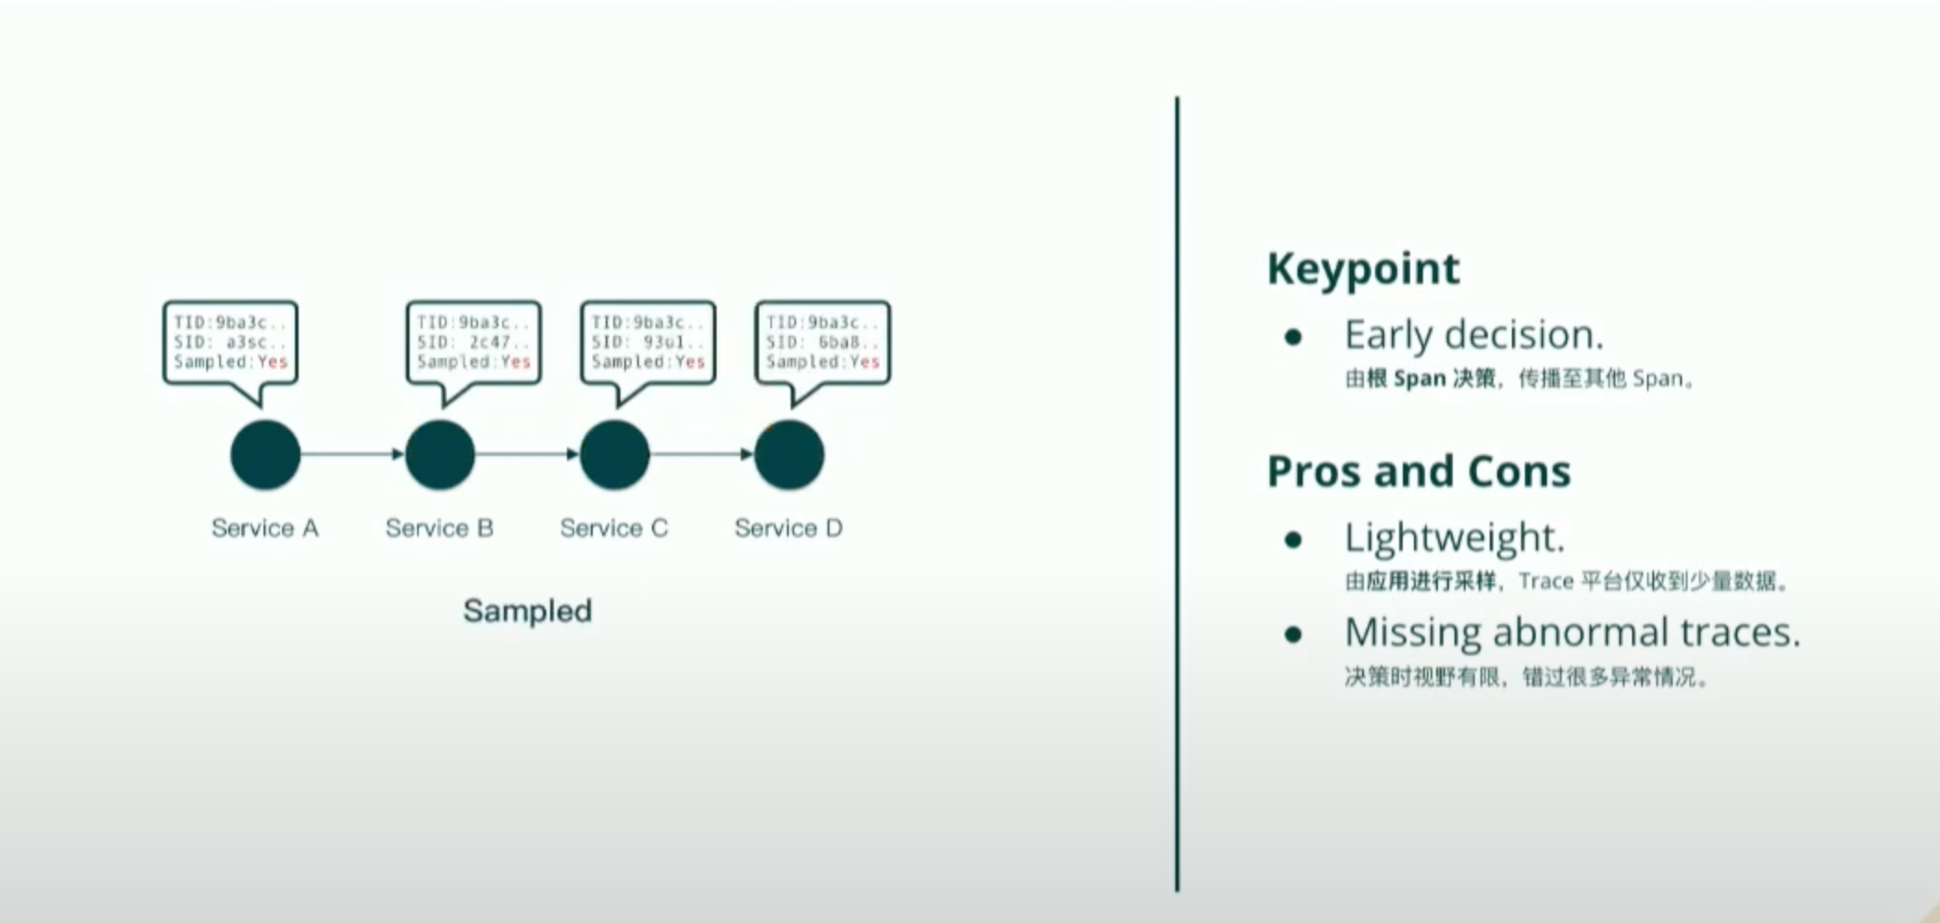
OpenTelemetry
Head-based Sampling

Slide 43
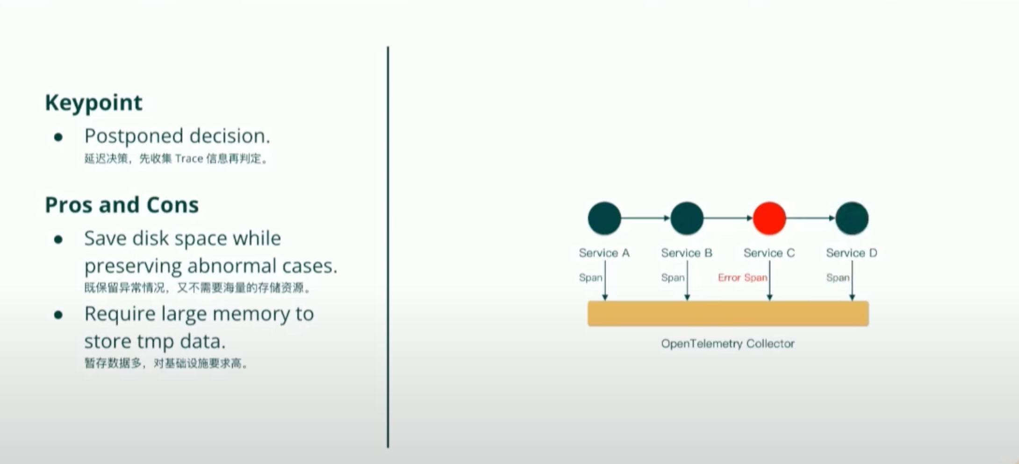
OpenTelemetry
Tail-based Sampling

Slide 44
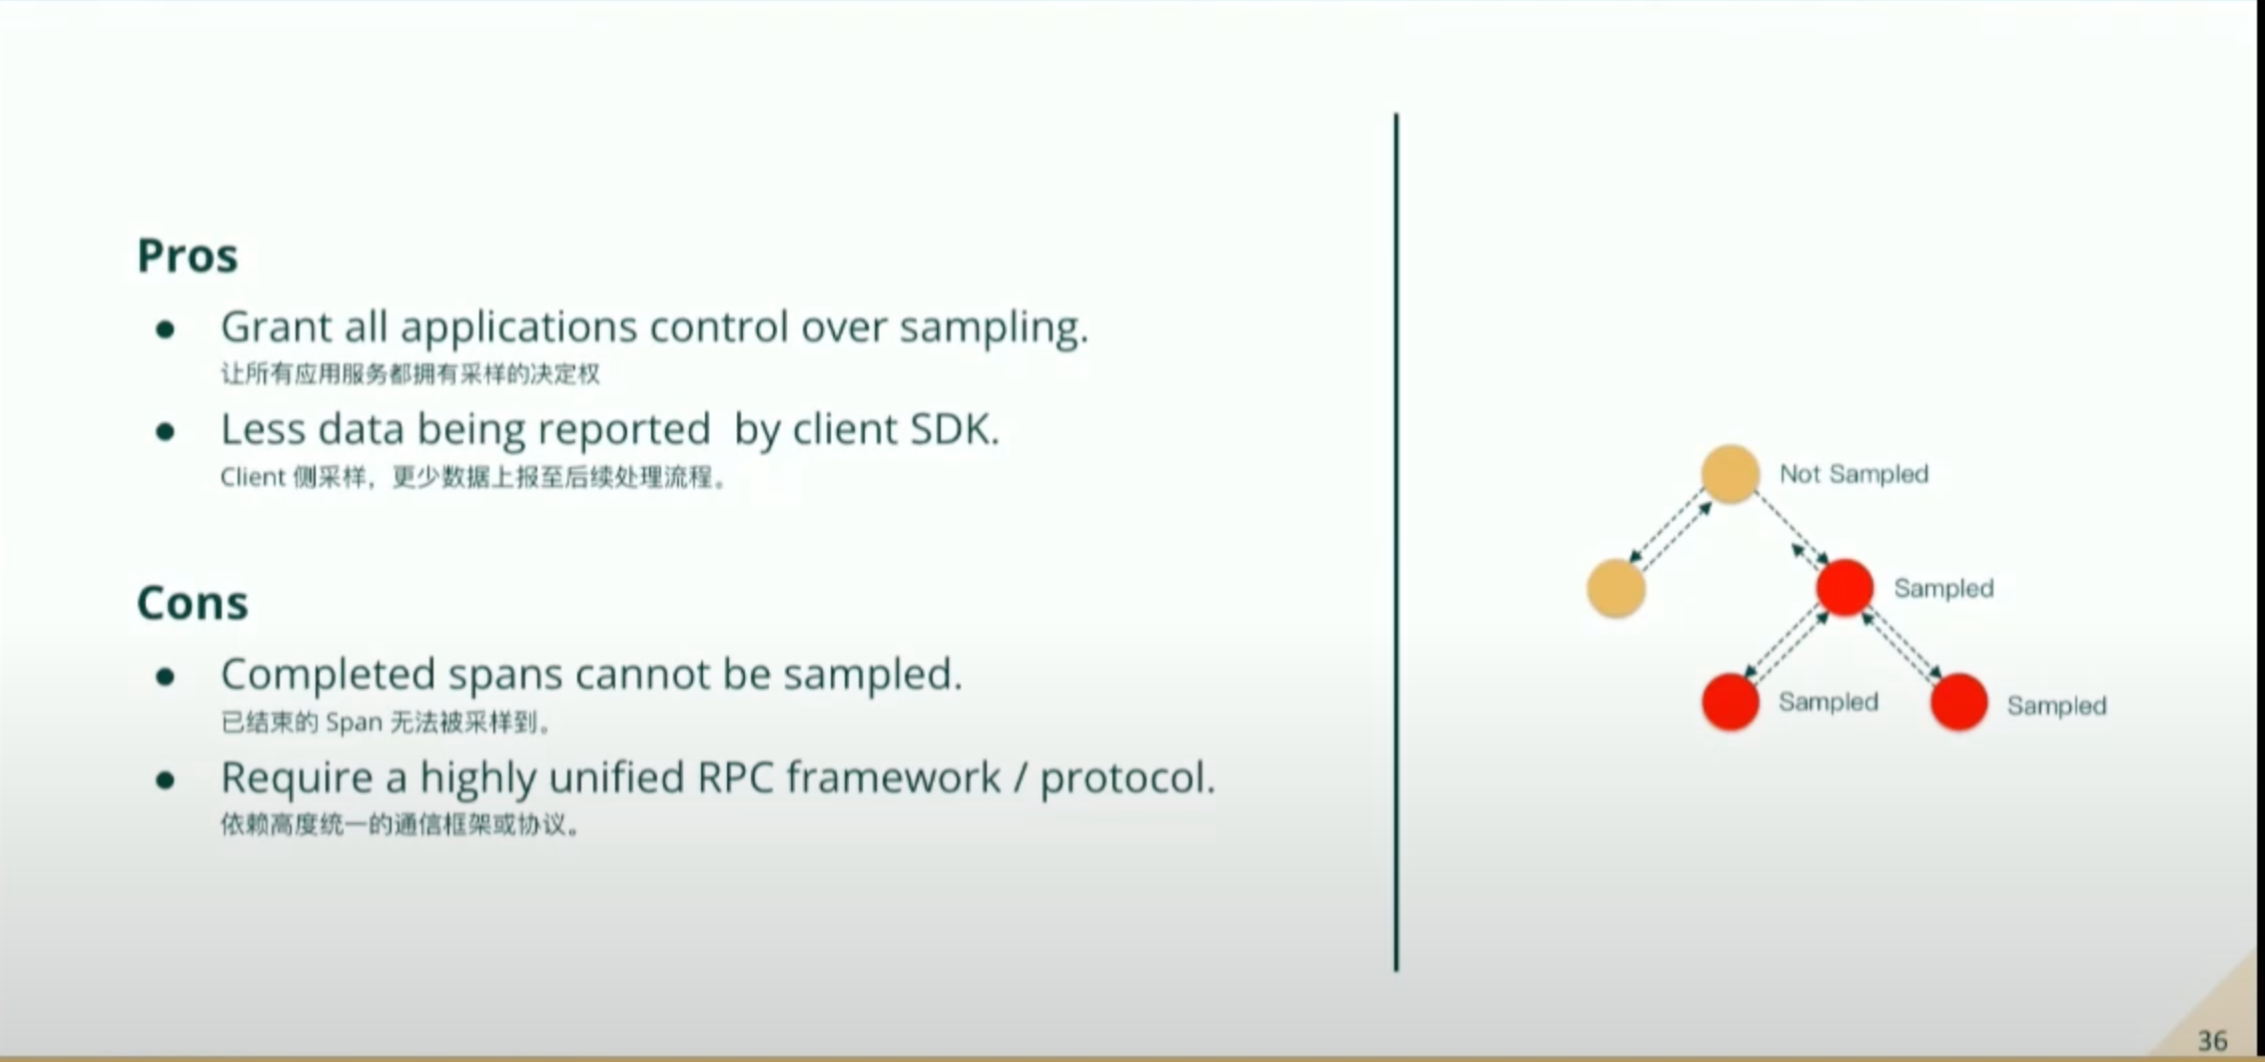
OpenTelemetry
Retroactive Sampling

Slide 45
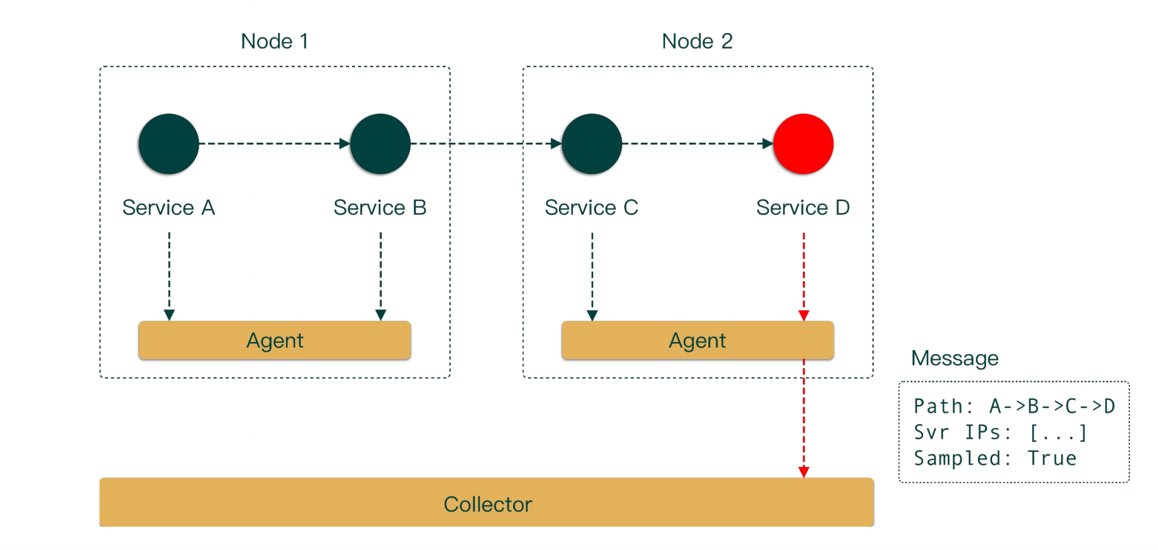
OpenTelemetry
Retroactive Sampling

Slide 46
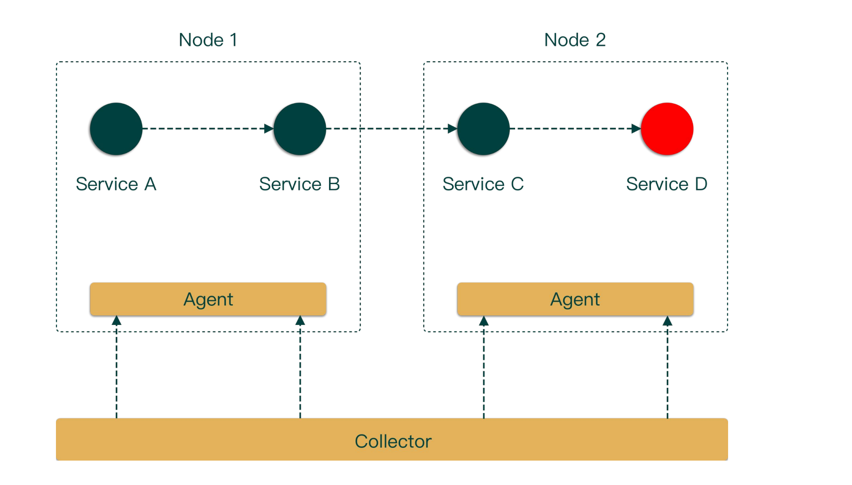
OpenTelemetry
Retroactive Sampling

Slide 47
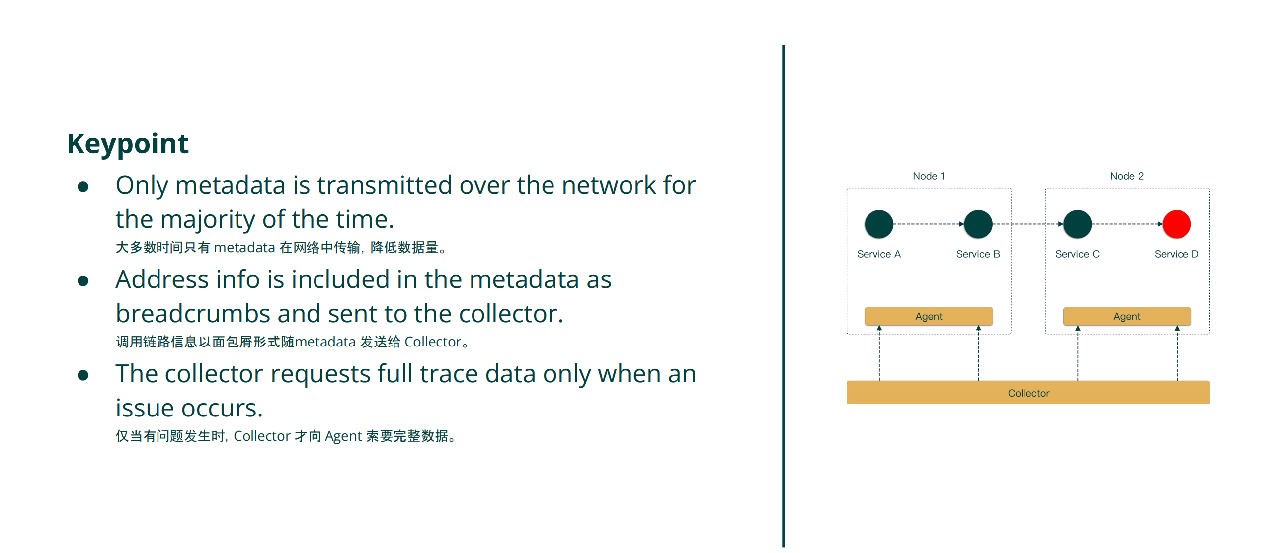
OpenTelemetry
Retroactive Sampling

Slide 48
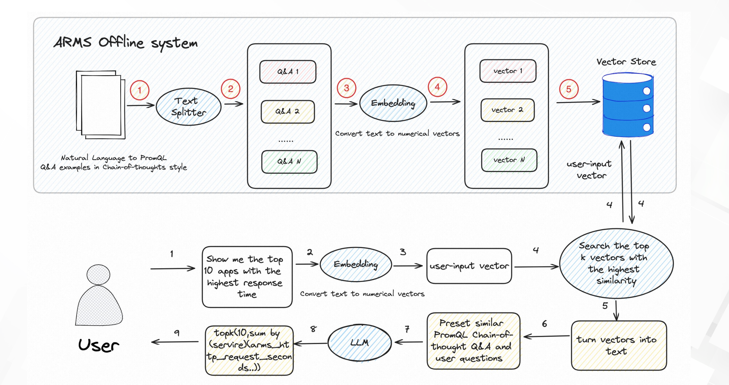
PromQL Chatbot
PromQL | Chat with Me and Get the PromQL You Want - Kunyi Chen, Alibaba Cloud

Slide 49
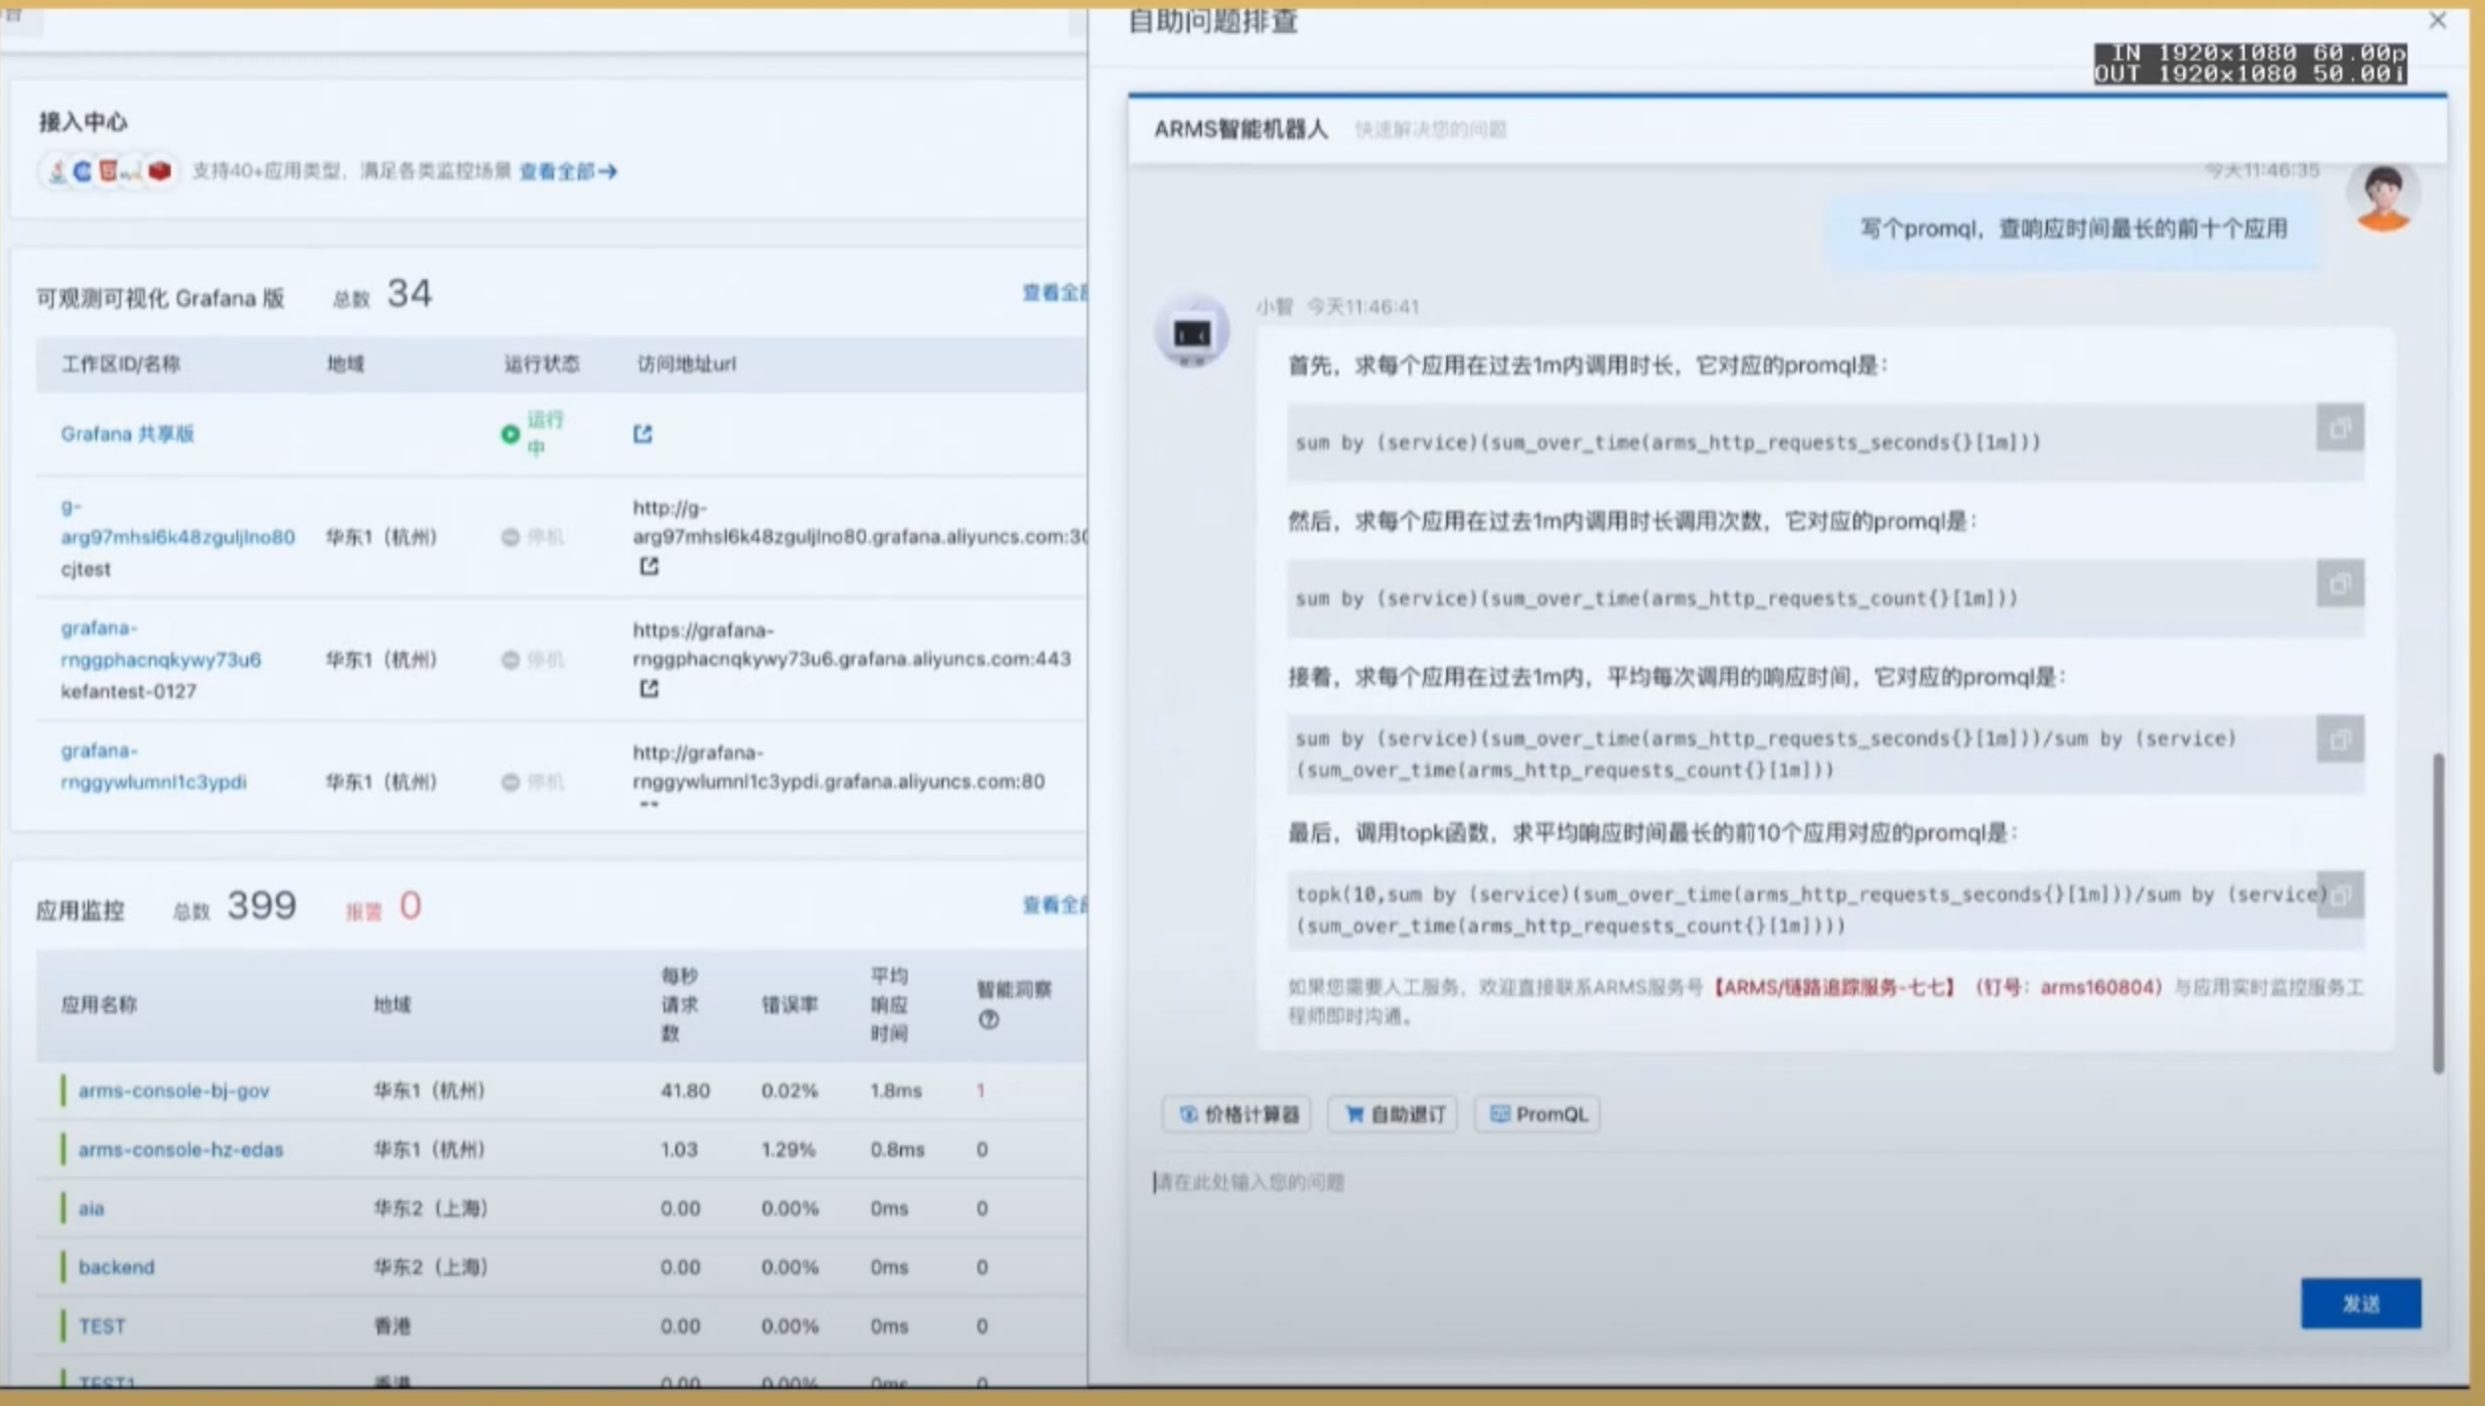
PromQL Chatbot

Slide 50
Scheduling

Slide 51
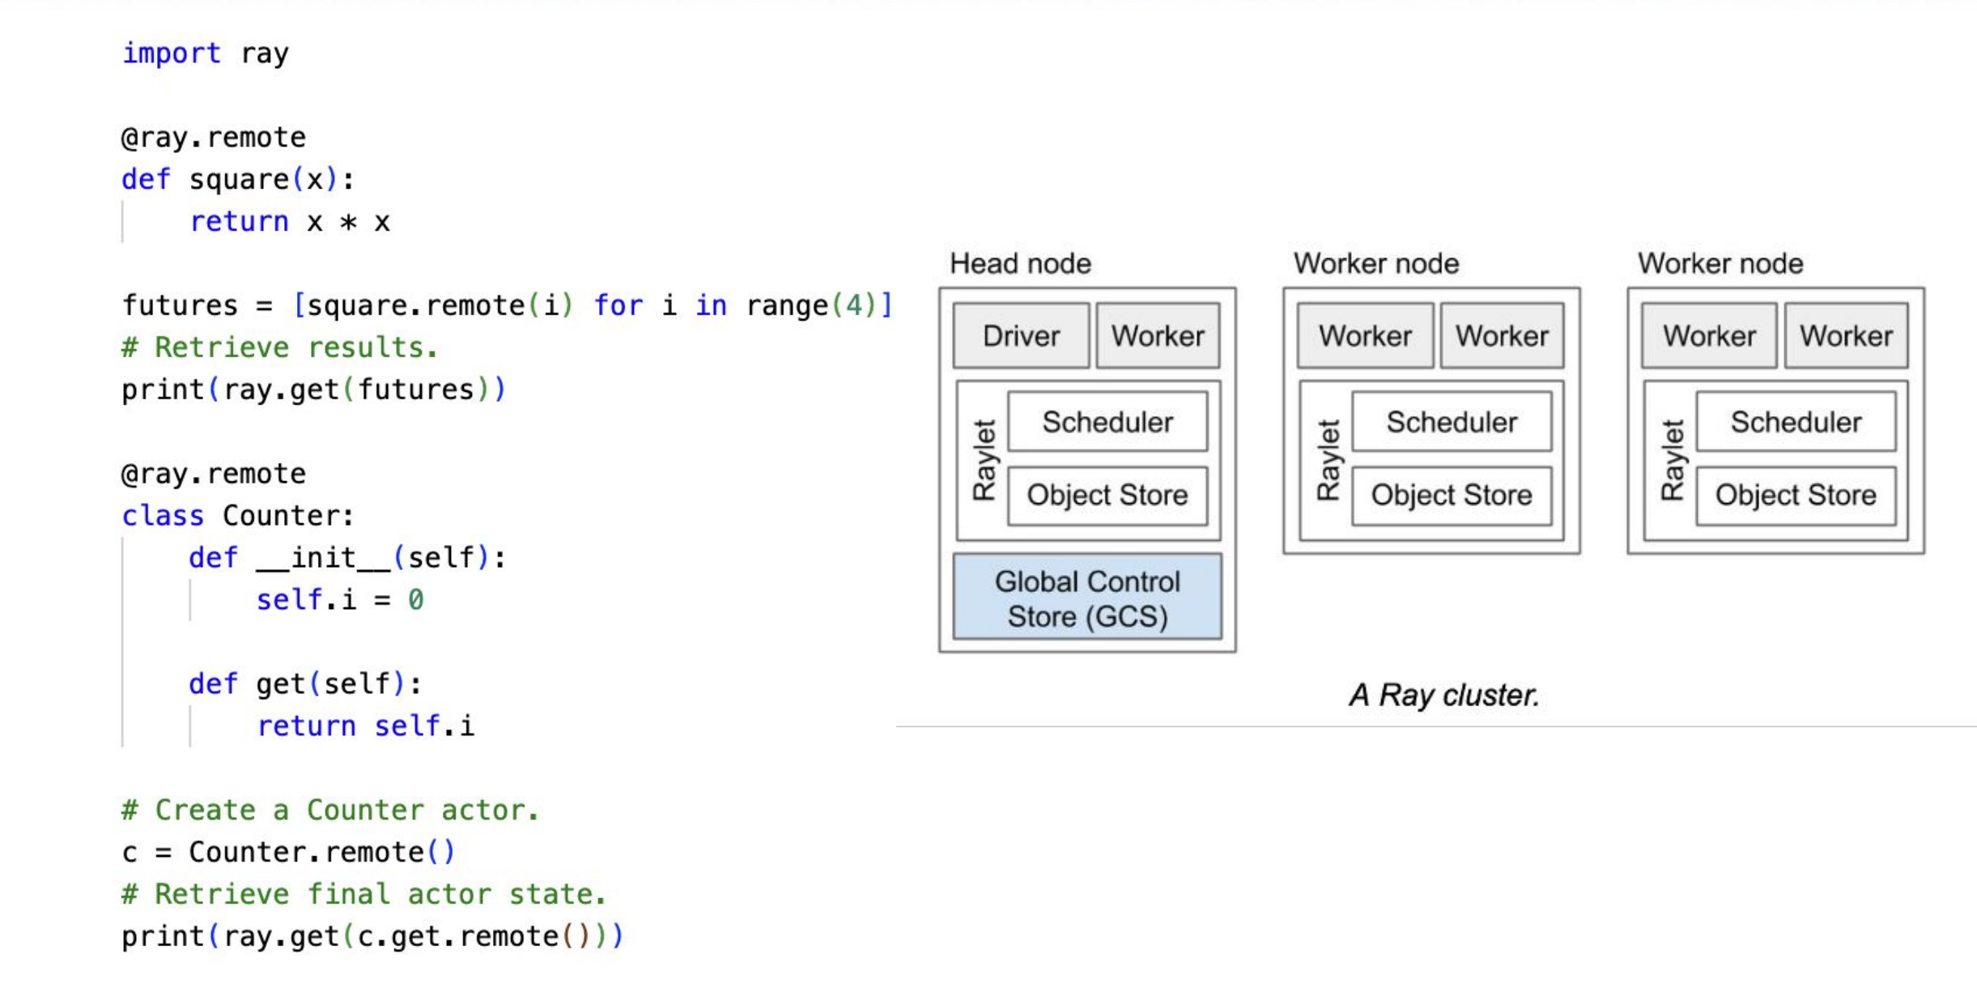
Ray + Kueue
Sailing Ray Workloads with KubeRay and Kueue in Kubernetes - Jason Hu, Volcano Engine & Kante Yin, DaoCloud

Slide 52
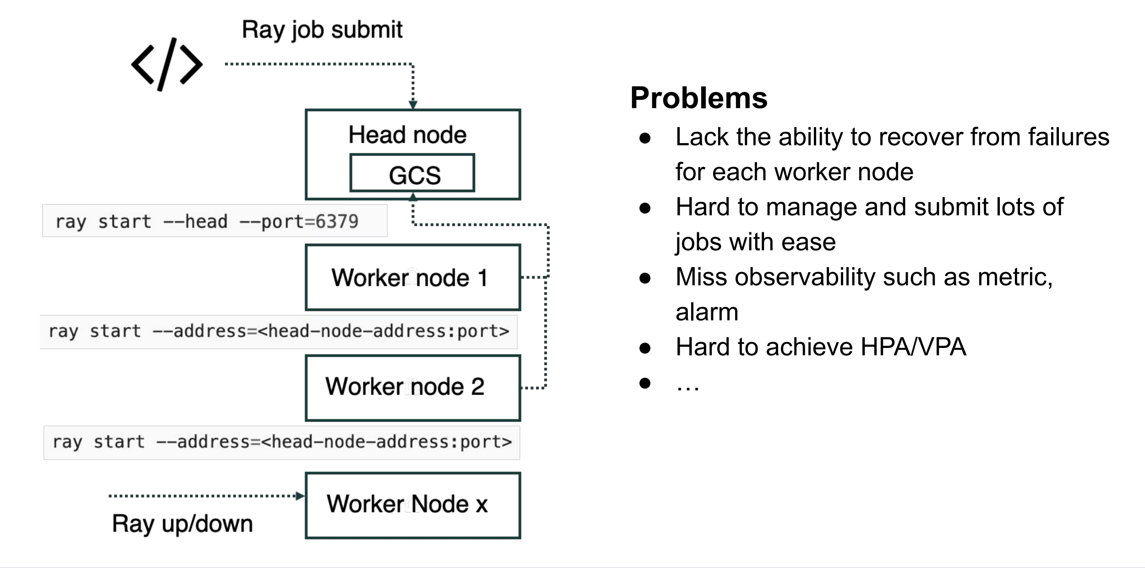
Ray + Kueue

Slide 53
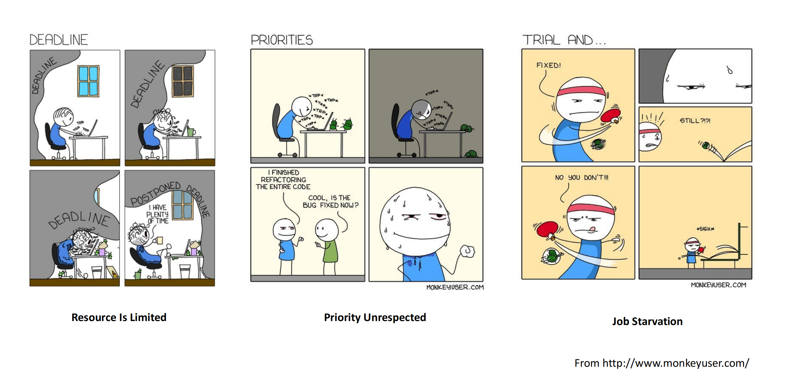
Ray + Kueue

Slide 54
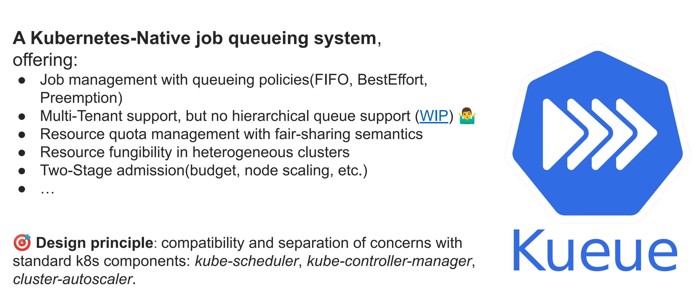
Ray + Kueue

Slide 55
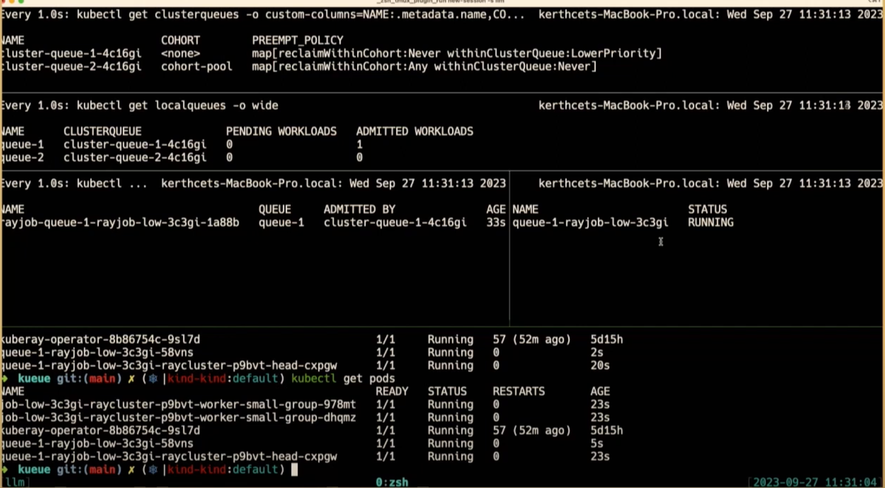
Ray + Kueue
Apply queue-1-rayjob-with low priority, resource sufficient

Slide 56
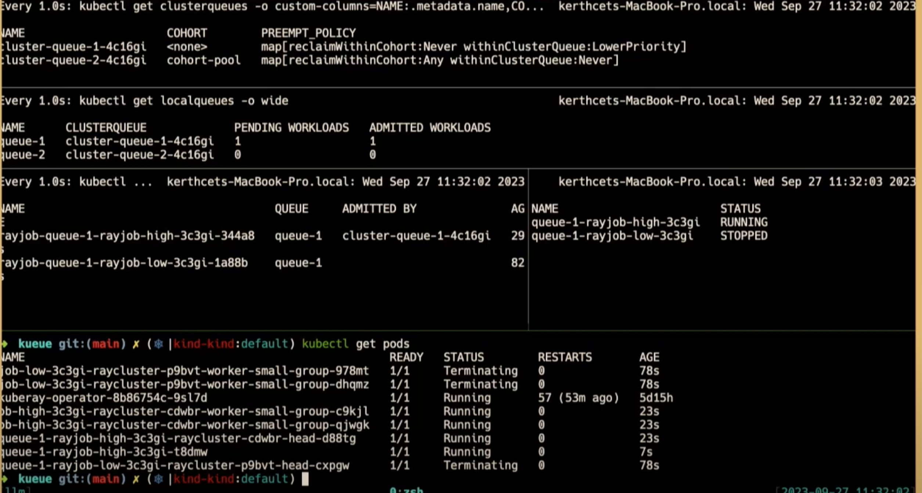
Ray + Kueue
Apply queue-1-rayjob-with-high-priority, resource insufficient, preemption

Slide 57
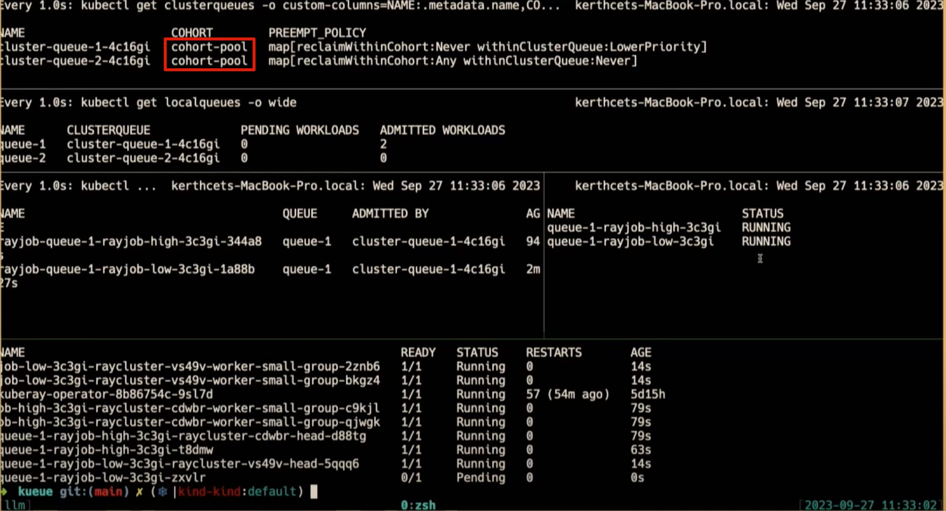
Ray + Kueue
Add cluster-queue-1 to cohort-pool for resource fair sharing

Slide 58
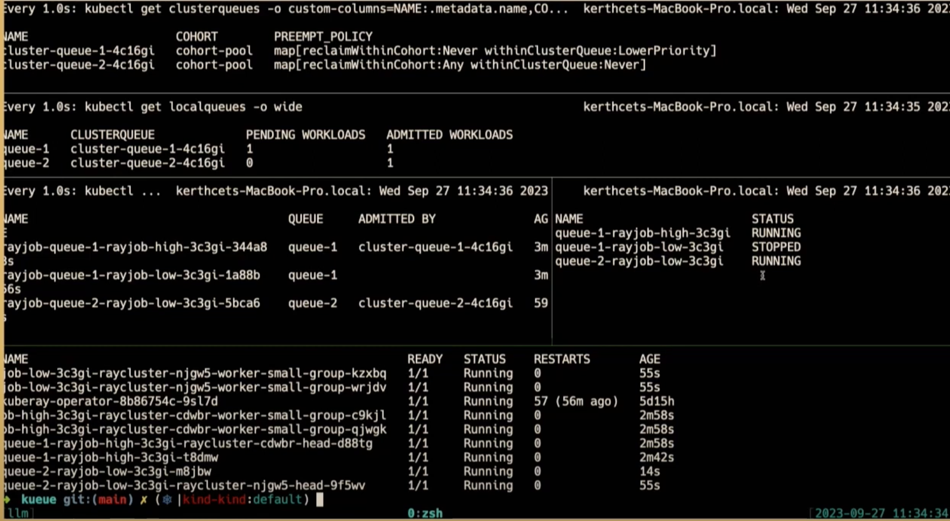
Ray + Kueue
Apply queue-2-rayjob-with-low-priority, resource insufficient, preemption

Slide 59
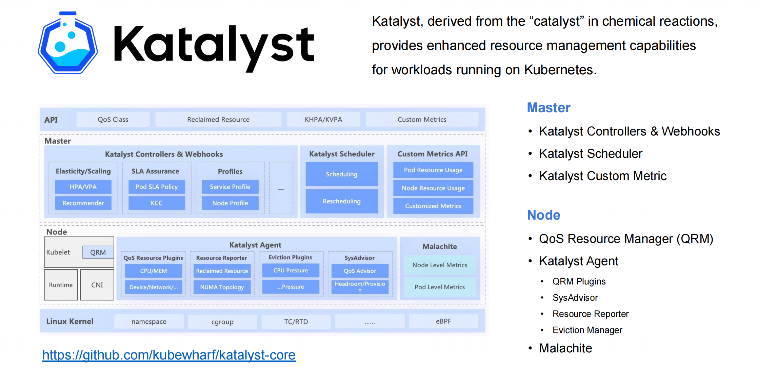
Katalyst
Building a Fine-Grained and Intelligent Resource Management System on Kubernetes - He Cao & Wei Shao, ByteDance

Slide 60

Katalyst

Slide 61

Katalyst

Slide 62

Katalyst

Slide 63

Katalyst

Slide 64

Koordinator
Enhance Workload QoS with Pluggable and Customizable Smarter Runtimes - Rougang Han, Alibaba & Kang Zhang, Intel

Slide 65

Koordinator

Slide 66

Koordinator
Different approaches to apply QoS resources

Slide 67

Koordinator

Slide 68
Multi Cluster

Slide 69

Karmada

Slide 70

Multi Cluster HPA
Break Through Cluster Boundaries to Autoscale Workloads Across Them on a Large Scale - Wei Jiang, Huawei Cloud & XingYan Jiang, DaoCloud
Multi-Cloud Multi-Cluster HPA Helps Trip.com Group Deal with Business Downturn and Rapid Recovery - Honghui Yue & Jingxue Li, Trip.com
FederatedHPA

Slide 71

Multi Cluster HPA
Distributed HPA

Slide 72

Multi Cluster HPA

Slide 73

Multi Cluster Network
Cross-Cluster Traffic Orchestration with eBPF - Xiaohui Zhang, Flomesh & Zhen Chang, Huawei Cloud
Multi Cluster service discovery

Slide 74

Multi Cluster Network

Slide 75

Multi Cluster Network

Slide 76
Gateway

Slide 77

Envoy Gateway
Envoy Gateway: The API Gateway in the Cloud Native Era - Xunzhuo Liu, Tencent & Huabing Zhao, Tetrate

Slide 78

Envoy Gateway

Slide 79

Envoy Gateway

Slide 80
Thank You

